Slide 1
Lightweight Scene Understanding and Synthetic Data-Driven Damage Inspection for Martian Rovers
Faculty of Information Engineering, Informatics, and Statistics
Master’s Degree in Computer Science
Venturini Daniele 1991255
Academic Year 2025/2026
Advisor
Prof. Marco Raoul Marini
Notes:
[Main presentation. Approximate time: 15–25 seconds.]
Good morning, my name is Daniele Venturini. My thesis focuses on two aspects of visual perception for Mars rovers: understanding the surrounding terrain and identifying possible wheel damage, while taking limited computing resources into account.
Option 1: "Here is how I have organized the presentation."
Option 2: "I will begin with a brief overview of the work."
Option 3: "Let me first outline the steps of the presentation."

Slide 2
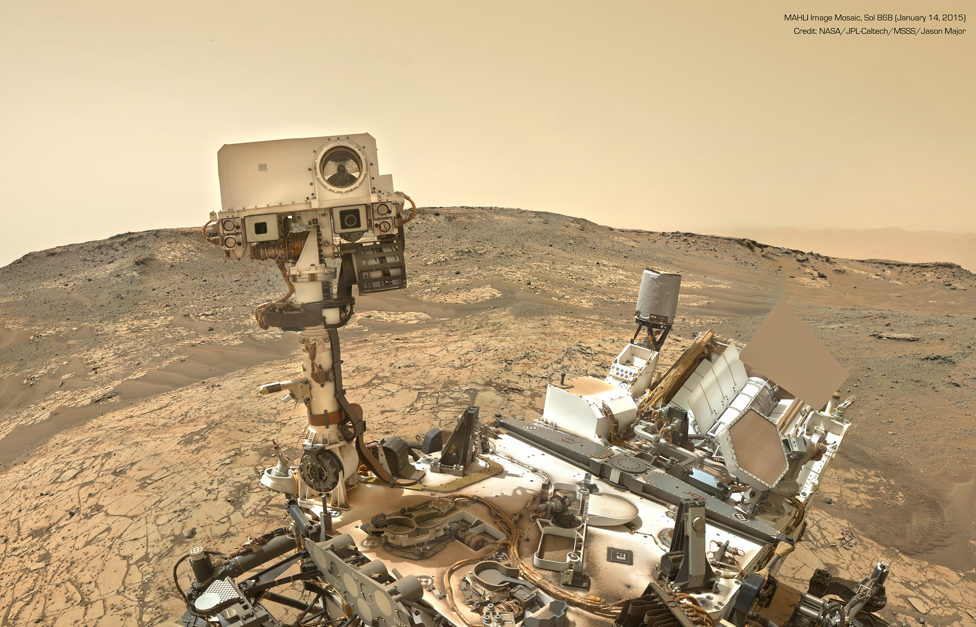
Introduction
Lightweight Scene Understanding
Synthetic Dataset Generation
Synthetic Damage Inspection
Results
Conclusions
Notes:
[Main presentation. Approximate time: 10–20 seconds.]
I will begin with the problem and the objectives. I will then present semantic segmentation, synthetic dataset generation and wheel inspection, followed by the results and conclusions.
Option 1: "Let's begin with the challenge facing Mars rovers."
Option 2: "The operational context explains why autonomy matters here."
Option 3: "First, I will explain the problem that motivated this work."

Slide 3







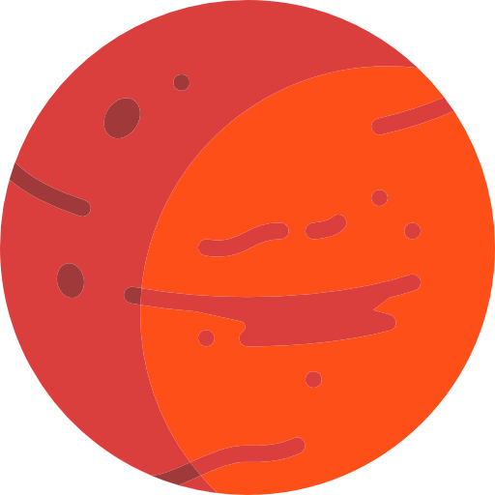
The challenge
Planning
Mars rover operations require constant supervision from Earth
On-board execution
a Report completion
b Request assistance
~4 - 22 minutes one way
[1]
Notes:
[Main presentation. Approximate time: 25–35 seconds.]
Most rover operations are planned and supervised from Earth. A signal takes approximately four to twenty-two minutes to reach Mars, so real-time intervention is not possible. The rover carries out the plan and reports the outcome, or requests assistance. Improving its ability to interpret images locally could reduce this dependence and support more autonomous decisions.
Option 1: "Wheel condition is another important part of this challenge."
Option 2: "Alongside interpreting the environment, the rover needs to monitor its condition."
Option 3: "A concrete example of this need is the damage observed on Curiosity's wheels."

Slide 4
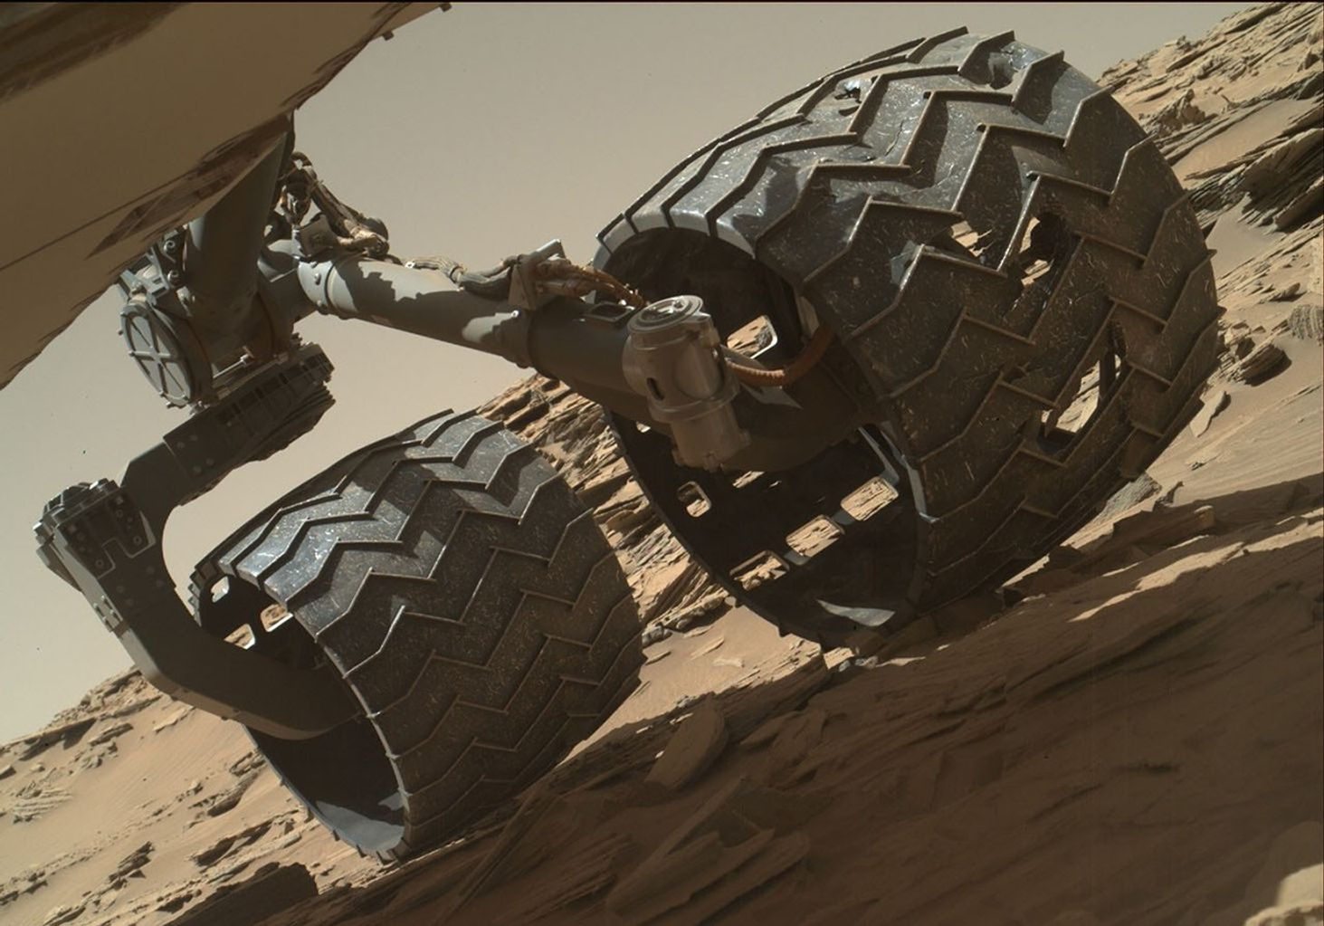
The challenge
Its mobility depends also on its conditions
Periodic manual inspection are performed, with large perforations already detected
NASA/JPL-Caltech/MSSS, sol 1315
[2] [3]
Notes:
[Main presentation. Approximate time: 20–30 seconds.]
Mobility also depends on the rover's condition. This image shows a real example of perforations in a Curiosity wheel. These conditions are currently monitored through periodic image inspections. An automatic system could flag suspicious observations and highlight areas to examine, helping to track damage over time and plan targeted inspections.
[LINKING OPTIONS: transition to slide 5 (Research objective). Choose one.]
Option 1: "These needs define the two objectives of my thesis."
Option 2: "This motivates a study of both scene understanding and wheel inspection."
Option 3: "I addressed these challenges through two separate research branches."
[Supporting sources, not to be read aloud: Thesis, Chapter 1; references [2] and [3].]

Slide 5
Research objective
Support autonomous operations while evaluating the trade-off between accuracy and efficiency
Main Objective:
1 Scene Understanding
Semantic segmentation of real Mars rover images
To support navigation
2 Wheel Inspection
Anomaly Detection using a synthetically generated dataset
To prevent further damage
Notes:
[Main presentation. Approximate time: 25–35 seconds.]
The objective is to study visual tools that support autonomy, considering both quality and efficiency. I developed two research branches: semantic segmentation of real Mars images to describe the scene, and wheel anomaly detection, for which I built a synthetic dataset. I evaluated the two branches separately. Integrating them is a direction for future work.
[LINKING OPTIONS: transition to slide 6 (Lightweight Scene Understanding). Choose one.]
Option 1: "I will begin with scene understanding."
Option 2: "First, I will focus on interpreting the surrounding terrain."
Option 3: "Let's look at the segmentation branch of the work."
[Supporting sources, not to be read aloud: Thesis, Chapters 1 and 8.]

Slide 6
Lightweight Scene Understanding
Introduction
Synthetic Dataset Generation
Synthetic Damage Inspection
Results
Conclusions
Notes:
[Main presentation. Approximate time: 5–15 seconds.]
I will start with the first branch: scene understanding using lightweight segmentation models.
[LINKING OPTIONS: transition to slide 7 (Semantic Segmentation). Choose one.]
Option 1: "The starting point is semantic segmentation."
Option 2: "I will first explain what the segmentation model produces."
Option 3: "Let's make this task concrete with an image and its reference mask."
[Supporting sources, not to be read aloud: Transition slide.]

Slide 7
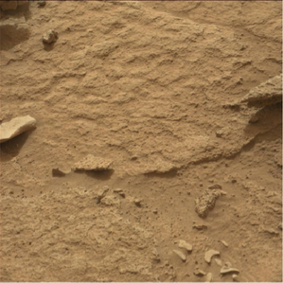
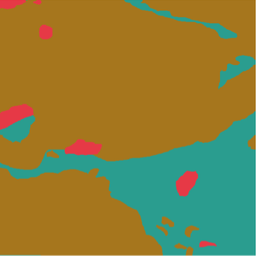
Semantic Segmentation
RGB observation
Ground truth
Bedrock
Sand / Soil
Rock
Notes:
[Main presentation. Approximate time: 25–35 seconds.]
Semantic segmentation assigns a class to every pixel. Starting from an RGB image, we want to distinguish regions such as rocks, sand and bedrock. The reference mask allows us to evaluate the prediction. The main metric is mean Intersection over Union, or mIoU, which measures the average overlap between predicted and annotated regions across the different classes.
[LINKING OPTIONS: transition to slide 8 (Datasets). Choose one.]
Option 1: "Next, I will introduce the datasets."
Option 2: "Evaluating these predictions requires annotated Mars images."
Option 3: "The following datasets provide the reference images and labels for this task."
[Supporting sources, not to be read aloud: Thesis, Chapter 2, task definition.]

Slide 8
Datasets
Mars-Bench is the first benchmark for Mars-related tasks.
S⁵Mars
MarsSeg MER / MSL
- Main segmentation dataset
- Curiosity Mastcam images 9 classes,
including Rover
- Cross-mission generalization
- 7 classes in both domains
Dataset | Training | Validation | Test
S5Mars | 4,997 | 200 | 800
MarsSeg MER | 2,893 | 413 | 828
MarsSeg MSL | 744 | 106 | 214
[4] [5]
Notes:
[Main presentation. Approximate time: 25–35 seconds.]
The main dataset is the version of S5Mars provided by Mars-Bench: real Curiosity images with nine classes, including Rover. I kept the training, validation and test splits shown here. To study generalization, I also used MarsSeg, which has seven classes and two domains: MSL, meaning Curiosity, and MER, meaning Spirit and Opportunity. Here, the aim is to understand what happens when the mission changes.
[LINKING OPTIONS: transition to slide 9 (Model Architectures). Choose one.]
Option 1: "I then compared several segmentation architectures."
Option 2: "With these datasets defined, I will introduce the models I evaluated."
Option 3: "The next step was to compare models with different sizes and architectures."
[Supporting sources, not to be read aloud: Thesis, Chapter 2, datasets; references [4] and [5].]

Slide 9
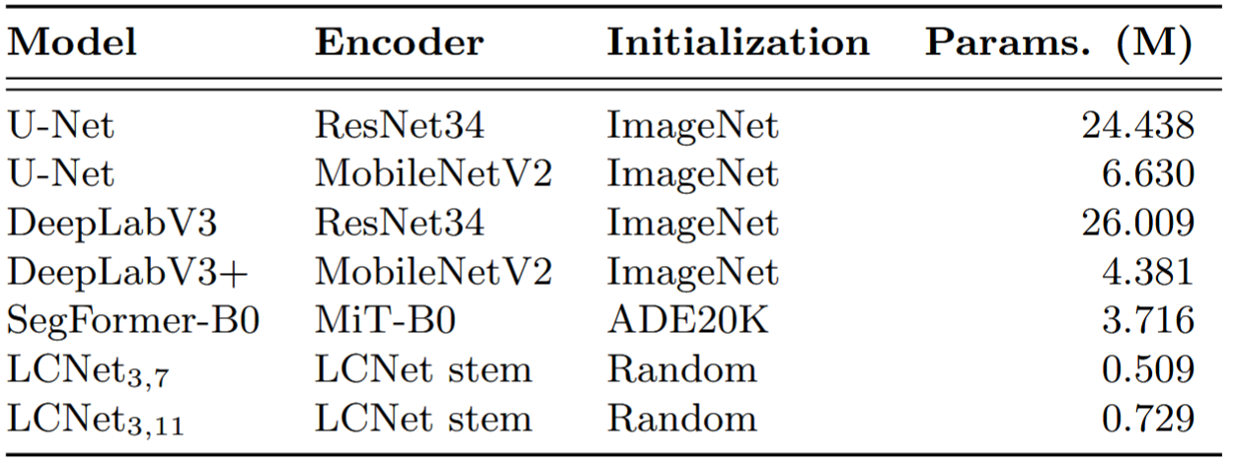
Model Architectures
[6] [7] [8] [9] [10]
Notes:
[Main presentation. Approximate time: 25–35 seconds.]
I compared seven configurations, ranging from U-Net and DeepLab CNNs to the lightweight LCNet variants and the SegFormer-B0 transformer. Changing the encoder lets us assess the relationship between model capacity and parameter count. SegFormer has about 3.7 million parameters, while LCNet has fewer than one million. Initialization also differs: LCNet starts from scratch, while the other models use pretrained weights.
[LINKING OPTIONS: transition to slide 10 (Training procedure). Choose one.]
Option 1: "Next, I will describe the training procedure."
Option 2: "These architectures were evaluated using the training setup shown next."
Option 3: "I will now explain how I trained the models and tested reduced precision."
[Supporting sources, not to be read aloud: Thesis, Chapter 2, architectures; references [6]–[10].]

Slide 10
Training procedure
Training setup
Loss and optimization
Quantization
512 × 512 input
ℒ = 0.5ℒ_{CE} + 0.5ℒ_{GDL}
Base models are in FP32
Batch size: 32
AdamW
LR: 10⁻⁴
FP16
PTQ INT8
QAT INT8
30 epochs
(60 for LCNet)
3-epoch warm-up
End-to-end training
Cosine LR decay
Notes:
[Main presentation. Approximate time: 30–40 seconds.]
Training uses images of 512 by 512 pixels, a batch size of 32 and thirty epochs, extended to sixty for LCNet. The loss combines cross-entropy and Generalized Dice with equal weights, bringing together pixel classification and region overlap. I use AdamW with warm-up and learning-rate decay. After training, I compare FP32, FP16, post-training quantization and quantization-aware training, which adapts the model to the effects of reduced precision.
[LINKING OPTIONS: transition to slide 11 (Synthetic Dataset Generation). Choose one.]
Option 1: "I will now turn to synthetic dataset generation."
Option 2: "The second research branch required a dataset for wheel inspection."
Option 3: "With the segmentation setup described, I will introduce the synthetic data used for damage inspection."
[Supporting sources, not to be read aloud: Thesis, Chapter 2, training and quantization; reference [11].]

Slide 11
Synthetic Dataset Generation
Introduction
Lightweight Scene Understanding
Synthetic Damage Inspection
Results
Conclusions
Notes:
[Main presentation. Approximate time: 5–15 seconds.]
I will now move on to the synthetic dataset, which makes it possible to study the second branch.
[LINKING OPTIONS: transition to slide 12 (Design Requirements). Choose one.]
Option 1: "First, I will explain the dataset requirements."
Option 2: "I began by defining the damage type and the data needed for training."
Option 3: "The dataset design follows the requirements of normal-only wheel inspection."
[Supporting sources, not to be read aloud: Transition slide.]

Slide 12


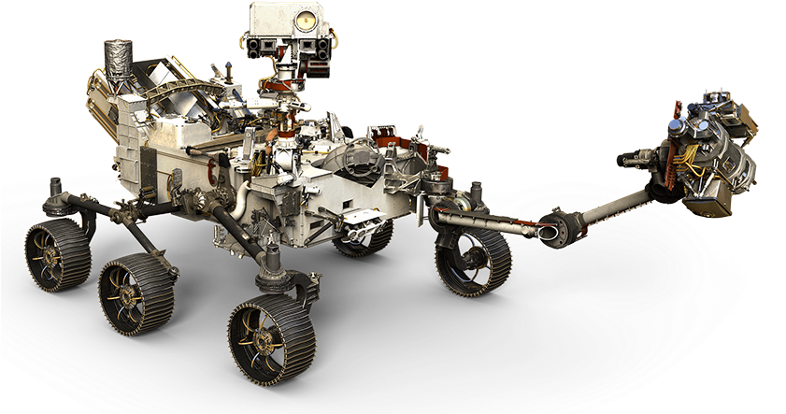
Design Requirements
Target Rover: Curiosity
1 anomaly class: wheel perforations
Training normal-only
Domain randomization to prevent overfitting
Pilot study
Notes:
[Main presentation. Approximate time: 25–35 seconds.]
Wheel inspection required data with specific perforation annotations. Among the resources I examined, I did not find a ready-to-use benchmark with these annotations. I therefore built a pilot study on Curiosity, limited to this damage type. Training contains only wheels without perforations. Dust and ordinary surface wear remain part of the normal appearance that the model must learn.
[LINKING OPTIONS: transition to slide 13 (Blender Scene). Choose one.]
Option 1: "I implemented these requirements in a Blender scene."
Option 2: "The next step was to build a controllable scene around the Curiosity model."
Option 3: "I will now show the scene used to generate the wheel images."
[Supporting sources, not to be read aloud: Thesis, Chapter 1 and Chapter 3, requirements.]

Slide 13
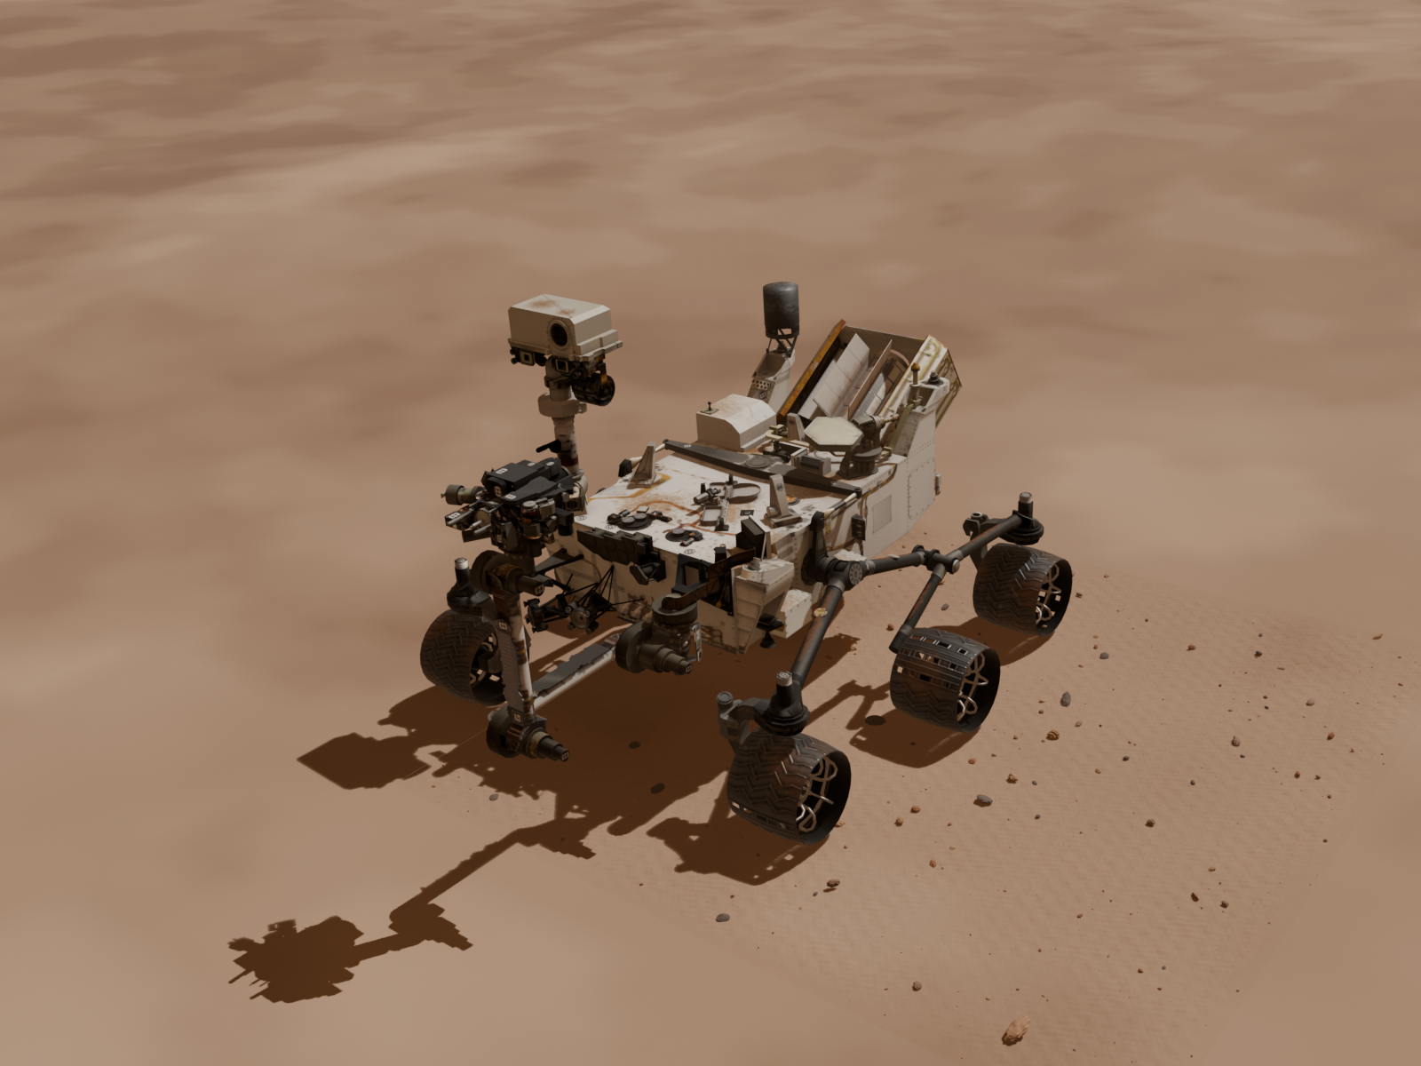
Blender Scene
NASA Curiosity asset
Gale Crater terrain (HiRISE)
Procedurally generated local terrain details
[12] [13]
Notes:
[Main presentation. Approximate time: 25–35 seconds.]
I built the scene in Blender using NASA's Curiosity model, separating the six wheels so that I could control them individually. The terrain comes from HiRISE data of Gale Crater. For close-up views, I added procedural details such as small surface variations and rocks. Keeping the rest of the rover also preserves shadows and occlusions that are consistent with the scene.
[LINKING OPTIONS: transition to slide 14 (Synthetic Damage). Choose one.]
Option 1: "I then introduced controlled synthetic damage."
Option 2: "With the scene in place, I could generate normal and damaged observations."
Option 3: "The next step was to create perforations and their reference masks."
[Supporting sources, not to be read aloud: Thesis, Chapter 3, scene preparation; references [12] and [13].]

Slide 14
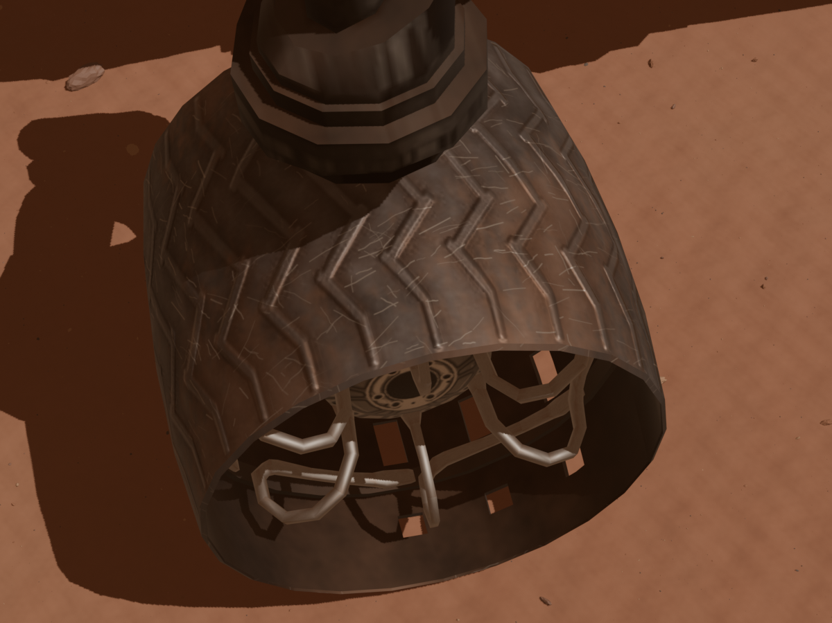


Synthetic Damage
Normal
Damaged
Damage mask
3 perforation levels by size: Small, Medium and Large
Both images in the same split Comparison of normal and damaged observation
Notes:
[Main presentation. Approximate time: 25–35 seconds.]
For each damaged observation, I generate a normal counterpart with the same camera, lighting and surface parameters. The intended difference is the hole. The damage mask is generated automatically. Holes fall into three size ranges: small, medium and large. Both images in a pair always stay in the same split, preventing nearly identical scenes from appearing in both training and test data.
[LINKING OPTIONS: transition to slide 15 (Domain Randomization). Choose one.]
Option 1: "I also varied the normal appearance of the scene."
Option 2: "To diversify these image pairs, I varied lighting, wear and viewpoint."
Option 3: "The next examples show how domain randomization changes the appearance of the observations."
[Supporting sources, not to be read aloud: Thesis, Chapter 3, synthetic damage and data splits.]

Slide 15
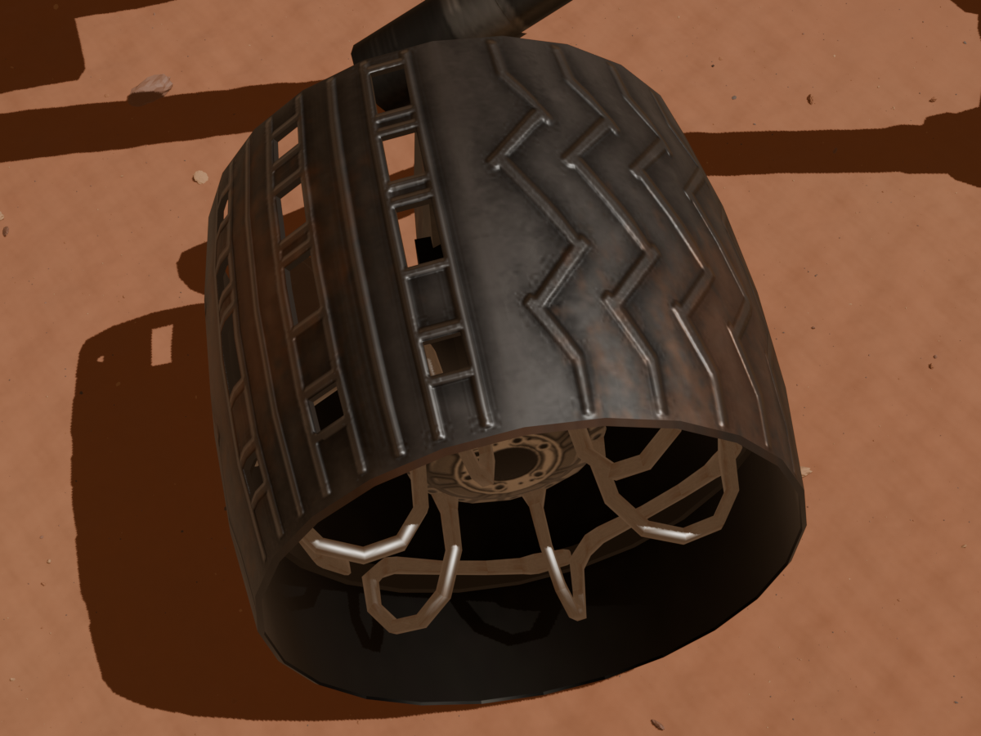
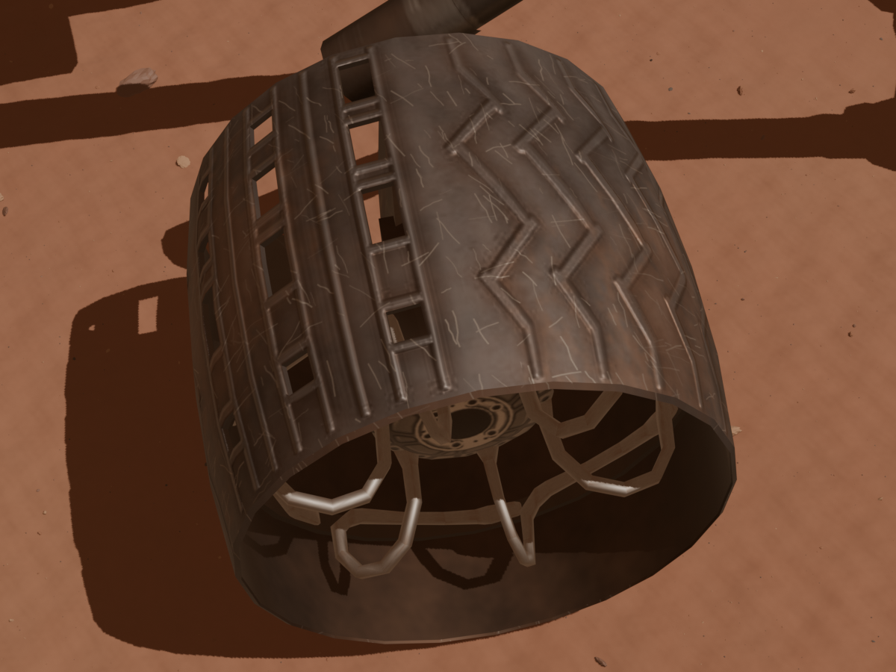
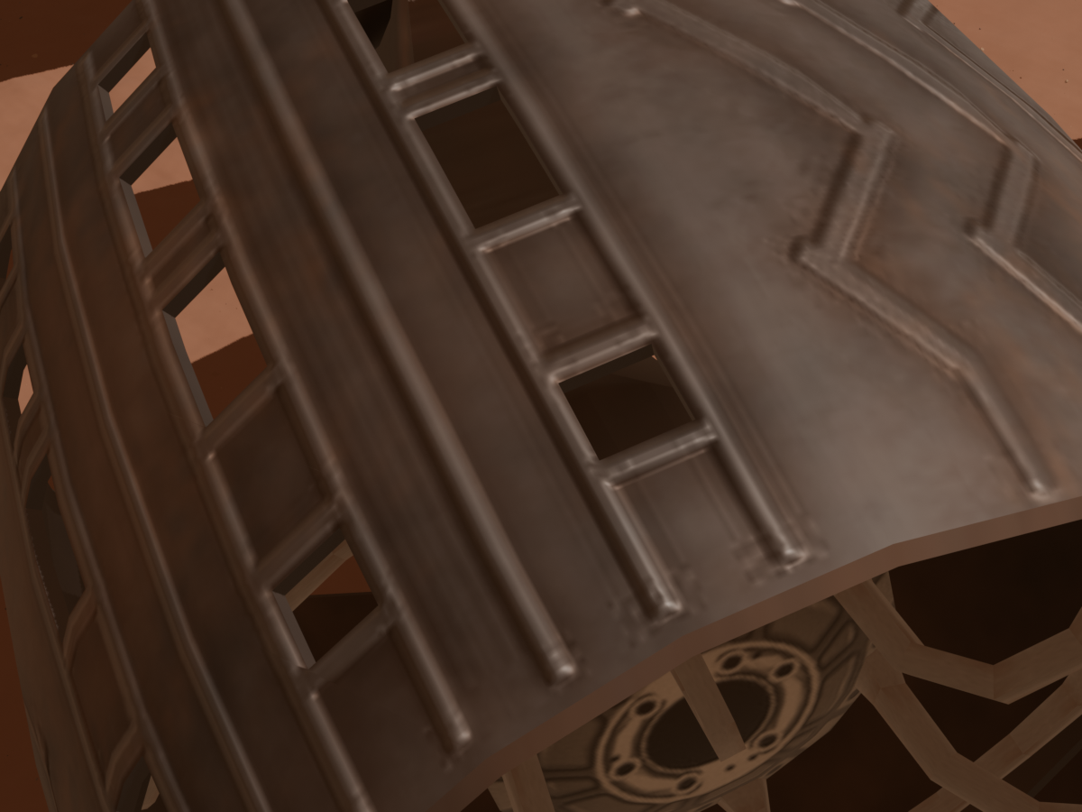
Domain Randomization
Clear Evident wear D: Upper detail
Dusty
75%
No extra wear
20%
A: Overhead
40%
Clear
25%
Light wear
45%
C1: Leading
27.5%
Evident wear
35%
C2: Trailing
27.5%
D: Upper detail
5%
[14]
Notes:
[Main presentation. Approximate time: 25–35 seconds.]
To diversify the appearance of the observations, I vary lighting, dust, wear and viewpoint. The percentages describe the chosen dataset composition: dusty conditions are more frequent, and there are four wheel views. Varying wear is particularly important because the detector must distinguish a perforation from a simple surface change.
Option 1: "These choices produced the following dataset."
Option 2: "I will now summarize the image counts and data splits."
Option 3: "This variation was organized into the training, validation and test sets shown next."
[Supporting sources, not to be read aloud: Thesis, Chapter 3, domain randomization; reference [14].]

Slide 16
Dataset Composition
10,000 RGB images across all 6 wheels
1200 × 900 resolution
Training: 7,000 normal
Validation : 750 normal 250 perforated
Test: 1,000 normal 1,000 perforated
Available on Kaggle
Notes:
[Main presentation. Approximate time: 20–30 seconds.]
The result is a dataset of ten thousand images, at 1200 by 900 pixels, covering all six wheels. Seven thousand normal images are reserved for training. Validation contains one thousand images, including 250 damaged images. The test set contains two thousand images, balanced between normal and damaged observations. The dataset is also available on Kaggle.
[LINKING OPTIONS: transition to slide 17 (Synthetic Damage Inspection). Choose one.]
Option 1: "I will now move on to wheel inspection."
Option 2: "With the dataset available, I could evaluate anomaly detection methods."
Option 3: "The next part explains how these synthetic images were used to detect damage."
[Supporting sources, not to be read aloud: Thesis, Chapter 3, final dataset composition.]

Slide 17
Synthetic Damage Inspection
Introduction
Lightweight Scene Understanding
Synthetic Dataset Generation
Results
Conclusions
Notes:
[Main presentation. Approximate time: 5–15 seconds.]
I will now show how I used these data for automatic wheel inspection.
[LINKING OPTIONS: transition to slide 18 (Anomaly Detection). Choose one.]
Option 1: "The task produces both a score and a map."
Option 2: "First, I will distinguish image-level detection from spatial localization."
Option 3: "I will begin by explaining what the anomaly detector learns and what it predicts."
[Supporting sources, not to be read aloud: Transition slide.]

Slide 18

Anomaly Detection
Aims to learn the normal wheel
appearance to detect and
localize potential damage
Normal-only training
Detection: Image anomaly score
Localization: Spatial anomaly map
Normal synthetic wheel sample
[15]
Notes:
[Main presentation. Approximate time: 20–30 seconds.]
Anomaly detection starts by learning the normal appearance of the wheel, using only images without perforations during training. At inference, it produces two outputs: a score for the whole image, indicating how suspicious it is, and a spatial map, indicating where to look for possible damage. Detection and localization therefore answer different questions and need to be evaluated separately.
[LINKING OPTIONS: transition to slide 19 (PatchCore and EfficientAD). Choose one.]
Option 1: "I will now introduce the first two methods."
Option 2: "PatchCore and EfficientAD approach normal appearance in different ways."
Option 3: "The first pair of models illustrates memory-based matching and teacher-student learning."
[Supporting sources, not to be read aloud: Thesis, Chapter 4, task and metrics; reference [15].]

Slide 19
Model Architectures
Goal: Compare AD approaches in term of accuracy and computational cost
1 PatchCore
- Stores normal patch features
in a memory bank
- Detects anomalies through
nearest-neighbor feature
distances
- Two backbones: ResNet18
(PC-S) or WideResNet50-2 (PC-L)
2 EfficientAD-S
- A students learns to reproduce a
frozen teacher’s normal features
- Teacher-student disagreement
highlights local anomalies
- An autoencoder branch captures
global context
[16] [17]
Notes:
[Main presentation. Approximate time: 25–35 seconds.]
PatchCore stores local descriptors from normal images and measures how far the descriptors of a new image are from these references. I considered a Small version with ResNet18 and a Large version with WideResNet50. EfficientAD-S instead uses a student network that learns to reproduce the features of a fixed teacher. Their disagreement signals local anomalies, while an autoencoder branch adds global information. The comparison includes both quality and computational cost.
[LINKING OPTIONS: transition to slide 20 (SuperSimpleNet and TinyGLASS). Choose one.]
Option 1: "The other two methods use artificial training anomalies."
Option 2: "SuperSimpleNet and TinyGLASS introduce synthetic perturbations during training."
Option 3: "I will now show the two approaches that learn from artificially altered normal observations."
[Supporting sources, not to be read aloud: Thesis, Chapter 4, PatchCore and EfficientAD; references [16] and [17].]

Slide 20
Model Architectures
Goal: Compare AD approaches in term of accuracy and computational cost
1 SuperSimpleNet
- Synthetic anomalies created by
localized gaussian noise to
features
- Separate heads for image
detection and spatial localization
2 TinyGLASS
- Compact ResNet18 backbone
- Combines image-space
alterations with features-space
perturbations
- Adapted to create specialized
hole like alterations
[18] [19]
Notes:
[Main presentation. Approximate time: 25–35 seconds.]
SuperSimpleNet creates localized perturbations in normal features and learns to distinguish them, with outputs for detection and localization. TinyGLASS uses a compact backbone and combines image alterations with feature perturbations. In our adaptation, some alterations imitate the appearance of holes. These artificial examples are created during training from normal images. The damaged images rendered in Blender remain reserved for evaluation.
[LINKING OPTIONS: transition to slide 21 (Preprocessing). Choose one.]
Option 1: "All four methods also require suitable preprocessing."
Option 2: "Before comparing the models, I will explain how the wheel images were prepared."
Option 3: "The next slide shows the crop and viewpoint used in the main comparison."
[Supporting sources, not to be read aloud: Thesis, Chapter 4, SSN and TinyGLASS; references [18]–[20].]

Slide 21
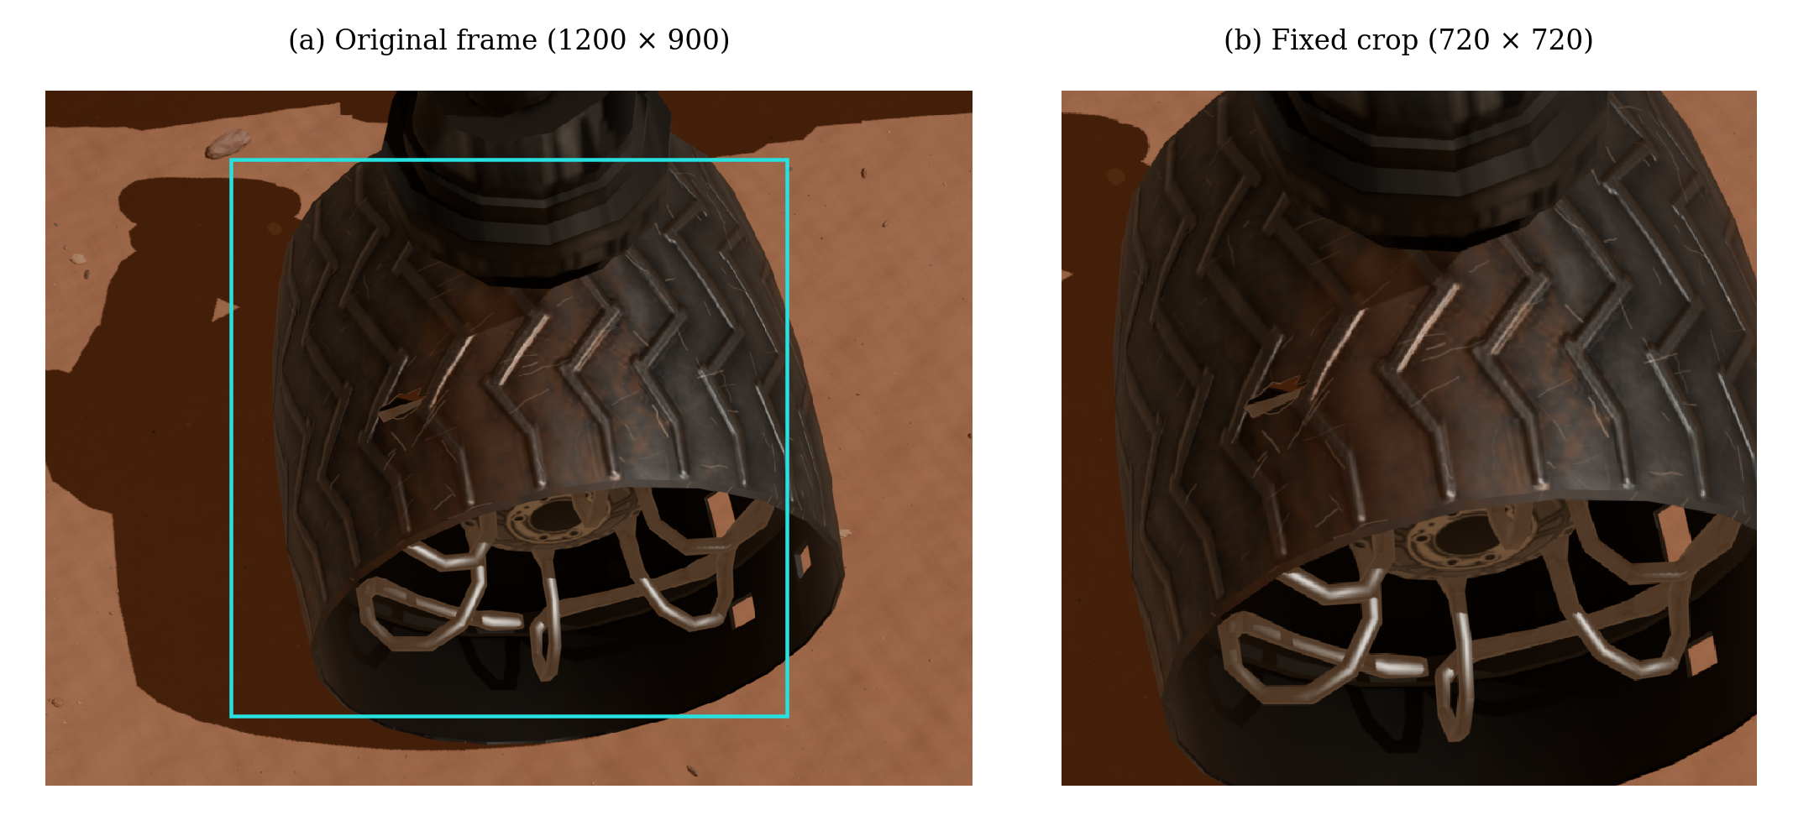
Preprocessing
Based on preliminary experiments, a fixed 720 × 720 crop and only one camera pose A was used
for training, because it helped having a single normal reference
Notes:
[Main presentation. Approximate time: 25–35 seconds.]
The preliminary experiments led us to focus the main comparison on pose A and a fixed crop of 720 by 720 pixels. This reduces the background and preserves more wheel detail before resizing to each model's required input. The crop does not use the damage mask. We retain variations in lighting, wear and wheel identity, while controlling the viewpoint.
[LINKING OPTIONS: transition to slide 22 (Results). Choose one.]
Option 1: "This completes the experimental setup."
Option 2: "With the datasets and methods defined, I can now present the results."
Option 3: "I will now move from the experimental design to the measured outcomes."
[Supporting sources, not to be read aloud: Thesis, Chapter 4, preprocessing; Chapter 6, experimental setup.]

Slide 22
Results
Introduction
Lightweight Scene Understanding
Synthetic Dataset Generation
Synthetic Damage Inspection
Conclusions
Notes:
[Main presentation. Approximate time: 5–15 seconds.]
I will now present the results, starting with segmentation and then moving on to wheel inspection.
[LINKING OPTIONS: transition to slide 23 (Semantic Segmentation: Quality). Choose one.]
Option 1: "I will start with segmentation quality."
Option 2: "The first results show how accurately the models segment the scene."
Option 3: "Let's begin with the segmentation comparison on the S5Mars test set."
[Supporting sources, not to be read aloud: Transition slide.]

Slide 23
Semantic Segmentation: Quality
75.55%
SegFormer-B0
3.72M parameters
S⁵Mars test mIoU, FP32 configurations
Notes:
[Main presentation. Approximate time: 25–35 seconds.]
In FP32, SegFormer-B0 achieves the highest mIoU on the S5Mars test set, at 75.55 percent, with about 3.72 million parameters. It therefore also outperforms DeepLabV3 with ResNet34, which has many more parameters. LCNet is more compact, but its quality is lower. Parameter count is only one aspect of efficiency, however. We also need to measure the actual inference cost.
[LINKING OPTIONS: transition to slide 24 (Cross-generalization). Choose one.]
Option 1: "I also tested generalization between missions."
Option 2: "The next comparison examines performance when the image domain changes."
Option 3: "Performance on S5Mars is one reference, so I also evaluated transfer between the MarsSeg domains."
[Supporting sources, not to be read aloud: Thesis, Chapter 5, segmentation accuracy.]

Slide 24
Cross-generalization
Model | MSL training mIoU |  | MER training mIoU
 | MSL test | MER test | MER test | MSL test
SegFormer-B0 | 70.63% | 52.06% | 66.75% | 48.11%
U-Net R34 | 71.80% | 27.43% | 67.76% | 13.82%
DeepLabV3 R34 | 71.10% | 28.11% | 67.77% | 9.28%
DeepLabV3+ MV2 | 68.98% | 38.27% | 65.10% | 12.86%
Separate training runs, no target fine-tuning
Notes:
[Main presentation. Approximate time: 25–35 seconds.]
Here I consider separate training runs on MarsSeg, without fine-tuning on the target domain. SegFormer retains about 52 percent mIoU when moving from MSL to MER, and 48 percent in the opposite direction, while the CNNs considered show larger drops. Even SegFormer remains below the reference models trained on the test domain. Transferring models between missions therefore remains an open problem.
[LINKING OPTIONS: transition to slide 25 (Semantic Segmentation: Efficiency). Choose one.]
Option 1: "Next, I will examine inference cost."
Option 2: "Alongside these accuracy results, I also measured computational efficiency."
Option 3: "For deployment, we also need to consider the cost of running these models."
[Supporting sources, not to be read aloud: Thesis, Chapter 5, cross-mission generalization on MarsSeg.]
[Additional result and source, not to be read aloud.]
DeepLabV3 ResNet34, MarsSeg evaluations supplied by the user on 26 October 2026: MSL in-domain mIoU 71.10%; MSL to MER zero-shot test mIoU 28.11%; MER in-domain mIoU 67.77%; MER to MSL zero-shot test mIoU 9.28%. The cross-dataset records specify the target test split and source-dataset last.ckpt checkpoint, with no target fine-tuning. Full-precision metrics, class IoUs, losses and configuration flags are archived in semantic_segmentation/outputs/cross_mission/2026-10-26/deeplabv3_resnet34_results.json. The original in-domain dictionaries do not explicitly contain a split or checkpoint field.

Slide 25
Semantic Segmentation: Efficiency
Model | Variant | Test mIoU (%) | Latency (ms) | Energy (mJ/image)
DeepLabV3+ MobileNetV2 | FP32 | 64.07 | 8.84 | 653.72
 | FP16 | 64.07 | 6.03 | 377.88
 | PTQ INT8 | 59.14 | 4.02 | 159.19
 | QAT INT8 | 65.63 | 3.01 | 115.34
SegFormer-B0 | FP32 | 75.55 | 11.88 | 835.72
 | FP16 | 75.55 | 7.17 | 432.07
 | PTQ INT8 | 75.60 | 5.92 | 327.99
 | QAT INT8 | 76.93 | 5.66 | 291.76
Best two results, NVIDIA T4, batch 1, forward pass only, preprocessing excluded
Notes:
[Main presentation. Approximate time: 30–40 seconds.]
Quantization highlights two trade-offs. SegFormer with QAT reaches 76.93 percent mIoU and reduces latency from 11.88 to 5.66 milliseconds. DeepLabV3+ with MobileNetV2 and QAT instead prioritizes cost: about three milliseconds and 115 millijoules per image, with lower quality. PTQ does not always preserve accuracy. Here, INT8 means selective mixed precision. These measurements cover inference on a T4 and exclude preprocessing. They do not yet represent a complete onboard system.
[LINKING OPTIONS: transition to slide 26 (Damage Inspection: Detection). Choose one.]
Option 1: "I will now turn to wheel damage detection."
Option 2: "The next results concern the second research branch."
Option 3: "Having compared segmentation quality and efficiency, I will move on to wheel inspection."
[Supporting sources, not to be read aloud: Thesis, Chapter 5, quantization results.]

Slide 26
Damage Inspection: Detection
86.43%
PatchCore-L
Synthetic pose-A test
Image AUROC on the test split
Notes:
[Main presentation. Approximate time: 25–35 seconds.]
For detection, PatchCore-L achieves the best result, with an Image AUROC of 86.43 percent, followed by SuperSimpleNet. AUROC measures how well the score separates normal and damaged images across different thresholds. It does not mean that this percentage of images was classified correctly. This result concerns the synthetic test set in pose A and should be considered together with cost and localization quality.
[LINKING OPTIONS: transition to slide 27 (Damage Inspection: Efficiency). Choose one.]
Option 1: "Detection quality also comes with an inference cost."
Option 2: "I will now compare the latency and energy required by these inspection models."
Option 3: "To assess the practical trade-off, the next table adds computational cost to the detection results."
[Supporting sources, not to be read aloud: Thesis, Chapter 6, detection on pose A.]

Slide 27
Damage Inspection: Efficiency
Model | Latency (ms) | GPU energy (J/image)
TinyGLASS-384 | 5.13 | 0.239
TinyGLASS-512 | 6.29 | 0.369
SuperSimpleNet | 27.54 | 1.939
EfficientAD-S | 57.72 | 4.032
PatchCore-L | 62.89 | 4.116
PatchCore-S | 101.21 | 6.849
NVIDIA T4, batch 1, forward pass only, preprocessing excluded
Notes:
[Main presentation. Approximate time: 25–35 seconds.]
For inference cost, TinyGLASS-384 has the advantage: 5.13 milliseconds and 0.239 joules per image. PatchCore-L instead requires about 63 milliseconds and 4.12 joules, although it offers better detection. There is therefore no winner across all objectives. Here too, we measure inference alone on a T4, with the input already on the GPU. Resolution and configuration are part of the trade-off being evaluated.
[LINKING OPTIONS: transition to slide 28 (Damage Inspection: Localization). Choose one.]
Option 1: "The maps show where the anomaly responses occur."
Option 2: "The remaining question is how precisely the damage is localized."
Option 3: "Next, I will compare the spatial quality of the predicted anomaly maps."
[Supporting sources, not to be read aloud: Thesis, Chapter 6, detector efficiency.]

Slide 28
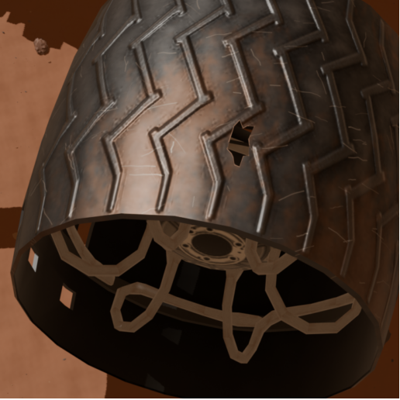
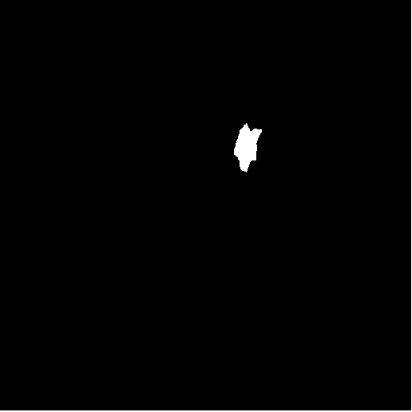
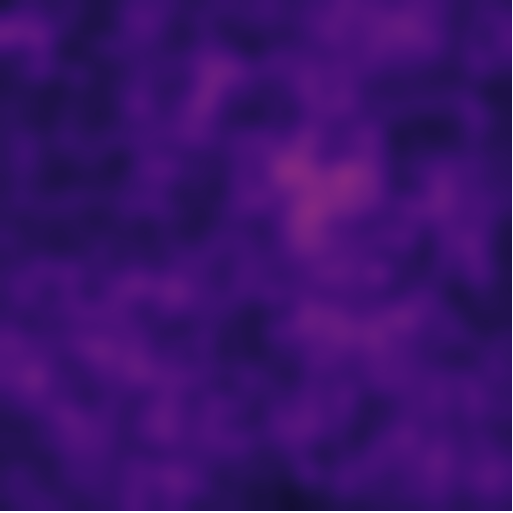
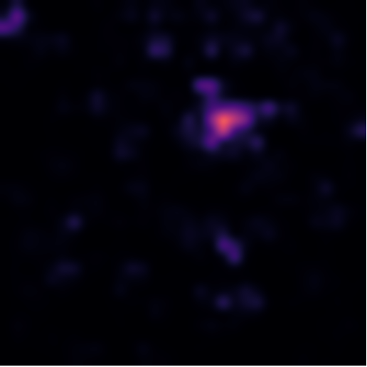
Damage Inspection: Localization
Observation
Ground truth
SuperSimpleNet
TinyGLASS-512
Pixel AP:
19.10%
27.59%
Notes:
[Main presentation. Approximate time: 30–40 seconds.]
Localization shows why the image score alone is not enough. In this example, SuperSimpleNet produces a more diffuse response, while TinyGLASS-512 concentrates its response closer to the hole. The Pixel AP values shown below, 19.10 and 27.59 percent, are measurements over the entire test set, rather than just the image shown. A model with better detection can therefore be less precise at locating damage, especially when the defect occupies only a few pixels.
[LINKING OPTIONS: transition to slide 29 (Conclusions section). Choose one.]
Option 1: "I can now summarize the main findings."
Option 2: "These results bring together the main trade-offs of the two research branches."
Option 3: "With detection and localization considered separately, I will move on to the conclusions."
[Supporting sources, not to be read aloud: Thesis, Chapter 6, localization and qualitative example.]

Slide 29
Conclusions
Introduction
Lightweight Scene Understanding
Synthetic Dataset Generation
Synthetic Damage Inspection
Results
Notes:
[Main presentation. Approximate time: 5–10 seconds.]
I will conclude by summarizing the contributions and the main directions that remain to be explored.
[LINKING OPTIONS: transition to slide 30 (Conclusions). Choose one.]
Option 1: "There are three main contributions to highlight."
Option 2: "The conclusions follow the segmentation, dataset and inspection parts of the work."
Option 3: "I will briefly summarize what each part of the thesis contributes."
[Supporting sources, not to be read aloud: Transition slide.]

Slide 30
Conclusions
Lightweight segmentation
Selective quantization lowers inference costs,
with accuracy preserved.
10,000 annotated synthetic images
A pilot dataset for rover wheel inspection,
with scope to improve visual realism.
Anomaly detection and localization
Four SOTA model families compared using configurations
tailored to wheel damage inspection.
Manuscript in preparation for submission to IEEE Transactions on Industrial Informatics
Notes:
Approximate speaking time: about 40–45 seconds.
To conclude, this work has produced three main contributions. The first concerns segmentation: lightweight models achieved promising results and, in the selected configurations, quantization reduced inference costs while preserving accuracy.
The second contribution is a synthetic dataset of ten thousand annotated images for wheel inspection. This is a pilot study: automatic generation provides control over the damage, while the visual realism can be improved further.
Finally, we compared four model families for anomaly detection and localization, adapting their configurations to the wheel inspection problem. This comparison provides a basis for further developments.
[LINKING OPTIONS: transition to slide 31 (Future Work). Choose one.]
Option 1: "These contributions also suggest several next steps."
Option 2: "The results leave a number of questions for future work."
Option 3: "I will finish by outlining how this work could be extended."
Scope of the results: the effects of quantization depend on the model and method. INT8 means selective mixed-precision execution. Cost measurements concern T4 inference, excluding preprocessing, CPU operations and data transfers. The anomaly detection comparison concerns the synthetic pose A subset from a single Curiosity asset. Transfer to real images remains to be validated.
Content source: Daniele Venturini, Lightweight Scene Understanding and Synthetic Data-Driven Damage Inspection for Martian Rovers, thesis, Chapter 8, Conclusions and Future Work, thesis/latex/Chapters/8 Conclusions and Future Work.tex. The results come from the thesis experiments. The VisionLab template and branding come from the presentation supplied by the user.

Slide 31
Future Work
Real-image validation
Validate synthetic-to-real transfer on rover images.
Extend domain variation and damage coverage.
Efficiency and deployment
Explore lighter models, augmentation and quantization.
Benchmark the full pipeline on representative hardware.
Branch Integration
Assess whether Rover semantic masks can help subsequent
damage inspection.
Notes:
[Main presentation. Approximate time: 25–35 seconds.]
One possible development is to connect the two branches: the Rover region could guide a wheel localizer, followed by damage inspection. The semantic mask alone does not identify individual wheels. I would also like to explore lighter models and augmentation methods suited to Mars images. Wheel inspection requires validation on real images, greater synthetic variability and additional damage types, so that we can assess how well these results generalize.
[LINKING OPTIONS: transition to slide 32 (Thank you). Choose one.]
Option 1: "This completes the work presented in my thesis."
Option 2: "With these next steps in mind, I will close the presentation."
Option 3: "These are the main directions I would like to explore next."
[Supporting sources, not to be read aloud: Thesis, Chapter 8, future work.]

Slide 32


Thank you for your attention
Questions?
QR GitHub
QR Kaggle
Notes:
[Main presentation. Approximate time: 5–10 seconds.]
Thank you for your attention. I am happy to take any questions.
[LINKING OPTIONS: closing alternatives. Choose one to replace the closing sentence above.]
Option 1: "Thank you for your attention. I am happy to take your questions."
Option 2: "That concludes my presentation. I would be happy to discuss any aspect of the work."
Option 3: "Thank you. The project links are on this slide, and I am happy to answer your questions."
[Supporting sources, not to be read aloud: Final slide of the main presentation.]

Slide 33
References
[1]
NASA Jet Propulsion Laboratory. How to Drive a Mars Rover.
On a Mission, Season 4, Episode 8, 25 August 2022.
jpl.nasa.gov, On a Mission, S4 E8
[2]
A. Rankin et al. Assessing Mars Curiosity Rover Wheel Damage.
IEEE Aerospace Conference, 2022, pp. 1–19.
robotics.jpl.nasa.gov, fmwi-rankin-2022-0225-final.pdf
[3]
NASA. Routine Inspection of Rover Wheel Wear and Tear.
NASA Science, 27 April 2016. Image PIA20334.
science.nasa.gov/resource/routine-inspection-of-rover-wheel-wear-and-tear/
[4]
J. Zhang et al. S⁵Mars: Semi-Supervised Learning for Mars Semantic Segmentation.
IEEE Transactions on Geoscience and Remote Sensing, vol. 62, 2024.
doi: 10.1109/TGRS.2024.3386756
[5]
M. Purohit et al. Mars-Bench: A Benchmark for Evaluating Foundation Models for Mars Science Tasks.
NeurIPS, Datasets and Benchmarks Track, 2025.
doi: 10.52202/085713-4098
Notes:
[References. No remarks are needed during the main presentation. If necessary:]
This page collects the sources on the operational context of rovers, Curiosity wheel inspections and the real segmentation datasets used as references for this work.
[LINKING OPTIONS: optional reference-page transition to slide 34. Choose one if continuing.]
Option 1: "The next page lists the segmentation model references."
Option 2: "The architecture papers are collected on the following reference page."
Option 3: "If useful, I can also show the original papers behind the segmentation models."
[Supporting sources, not to be read aloud: Presentation bibliography, references [1]–[5].]

Slide 34
References
[6]
O. Ronneberger, P. Fischer and T. Brox. U-Net: Convolutional Networks for Biomedical Image Segmentation.
MICCAI, 2015, pp. 234–241.
doi: 10.1007/978-3-319-24574-4_28
[7]
L.-C. Chen et al. Rethinking Atrous Convolution for Semantic Image Segmentation.
arXiv:1706.05587, 2017.
arxiv.org/abs/1706.05587
[8]
L.-C. Chen et al. Encoder-Decoder with Atrous Separable Convolution for Semantic Image Segmentation.
ECCV, 2018, pp. 833–851.
doi: 10.1007/978-3-030-01234-2_49
[9]
E. Xie et al. SegFormer: Simple and Efficient Design for Semantic Segmentation with Transformers.
NeurIPS, vol. 34, 2021, pp. 12077–12090.
arxiv.org/abs/2105.15203
[10]
M. Shi et al. Lightweight Context-Aware Network Using Partial-Channel Transformation for Real-Time Semantic Segmentation.
IEEE Transactions on Intelligent Transportation Systems, 25(7), 2024.
doi: 10.1109/TITS.2023.3348631
Notes:
[References. No remarks are needed during the main presentation. If necessary:]
This page lists the original papers for the segmentation families compared: U-Net, DeepLabV3, DeepLabV3+, SegFormer and LCNet. The encoder variants used in the experiments are specified on the slide dedicated to the models.
[LINKING OPTIONS: optional reference-page transition to slide 35. Choose one if continuing.]
Option 1: "The following references cover the methods and scene assets."
Option 2: "The next page includes the quantization and synthetic-data references."
Option 3: "I will continue with the sources for quantization, scene construction and the inspection protocol."
[Supporting sources, not to be read aloud: Presentation bibliography, references [6]–[10].]

Slide 35
References
[11]
B. Jacob et al. Quantization and Training of Neural Networks for Efficient Integer-Arithmetic-Only Inference.
CVPR, 2018, pp. 2704–2713.
arxiv.org/abs/1712.05877
[12]
NASA Visualization Technology Applications and Development. Curiosity 3D Model.
NASA Science, 22 April 2019.
science.nasa.gov/resource/curiosity-3d-model/
[13]
HiRISE. Possible MSL Landing Site in Gale Crater.
DTM and orthoimage, PSP_010573_1755 and PSP_010639_1755.
hirise.lpl.arizona.edu/dtm/dtm.php?ID=PSP_010573_1755
[14]
J. Tobin et al. Domain Randomization for Transferring Deep Neural Networks from Simulation to the Real World.
IEEE/RSJ IROS, 2017, pp. 23–30.
doi: 10.1109/IROS.2017.8202133
[15]
P. Bergmann et al. MVTec AD: A Comprehensive Real-World Dataset for Unsupervised Anomaly Detection.
CVPR, 2019, pp. 9584–9592.
doi: 10.1109/CVPR.2019.00982
Notes:
[References. No remarks are needed during the main presentation. If necessary:]
These references cover quantization, NASA's three-dimensional model and the HiRISE data used to build the scene, domain randomization and the normal-only anomaly detection protocol.
[LINKING OPTIONS: optional reference-page transition to slide 36. Choose one if continuing.]
Option 1: "The next page lists the anomaly detection papers."
Option 2: "The inspection methods have their own reference page."
Option 3: "These are followed by the original papers for the four anomaly detection families."
[Supporting sources, not to be read aloud: Presentation bibliography, references [11]–[15].]

Slide 36
References
[16]
K. Roth et al. Towards Total Recall in Industrial Anomaly Detection.
CVPR, 2022, pp. 14318–14328.
arxiv.org/abs/2106.08265
[17]
K. Batzner, L. Heckler and R. König. EfficientAD: Accurate Visual Anomaly Detection at Millisecond-Level Latencies.
WACV, 2024, pp. 128–138.
arxiv.org/abs/2303.14535
[18]
B. Rolih, M. Fučka and D. Skočaj. SuperSimpleNet: Unifying Unsupervised and Supervised Learning for Fast and Reliable Surface Defect Detection.
ICPR 2024, LNCS 15310, Springer, 2025, pp. 47–65.
doi: 10.1007/978-3-031-78192-6_4
[19]
B. Rolih, M. Fučka and D. Skočaj. No Label Left Behind: A Unified Surface Defect Detection Model for All Supervision Regimes.
Journal of Intelligent Manufacturing, vol. 37, 2026, pp. 3189–3209.
doi: 10.1007/s10845-025-02680-8
[20]
P. Bonazzi et al. TinyGLASS: Real-Time Self-Supervised In-Sensor Anomaly Detection.
arXiv:2603.16451v3, 2026. Accepted at AICAS 2026.
arxiv.org/abs/2603.16451v3
Notes:
[References. No remarks are needed during the main presentation. If necessary:]
This page lists the reference papers for PatchCore, EfficientAD, SuperSimpleNet and TinyGLASS. For SuperSimpleNet, it includes both the initial paper and the extended formulation, which also provides the architecture diagram in the extra slides.
[LINKING OPTIONS: optional Q&A transition to slide 37 (Lighting and wear variations). Choose one if relevant.]
Option 1: "I can also show examples of the dataset variations."
Option 2: "If useful, the extra slides illustrate the lighting and wear conditions."
Option 3: "For more detail on the synthetic data, I can show how normal appearance varies."
[Supporting sources, not to be read aloud: Presentation bibliography, references [16]–[20].]

Slide 37

Extra: variations
Lighting: Dusty (75%)
Lighting: Clear (25%)
Wear: None added (20%)
Wear: Evident (35%)
Wear: Light (45%)
Notes:
[Extra slide. Optional remarks for the Q&A, outside the 15-minute presentation.]
These examples show the variations considered normal. Seventy-five percent of the dataset uses the dusty preset and twenty-five percent uses the clear preset. For wear, twenty percent retains the surface without added wear, forty-five percent introduces light wear and thirty-five percent introduces visible wear. An image can therefore be normal even if the wheel looks dirty or scratched. The anomaly being modeled is a perforation.
[LINKING OPTIONS: optional Q&A transition to slide 38 (Viewpoints and hole sizes). Choose one if relevant.]
Option 1: "The next examples cover viewpoints and hole sizes."
Option 2: "Lighting and wear are complemented by variations in viewpoint and defect size."
Option 3: "I can also show how the camera views and perforation sizes are distributed."
[Supporting sources, not to be read aloud: Thesis, Chapter 3, domain randomization.]

Slide 38
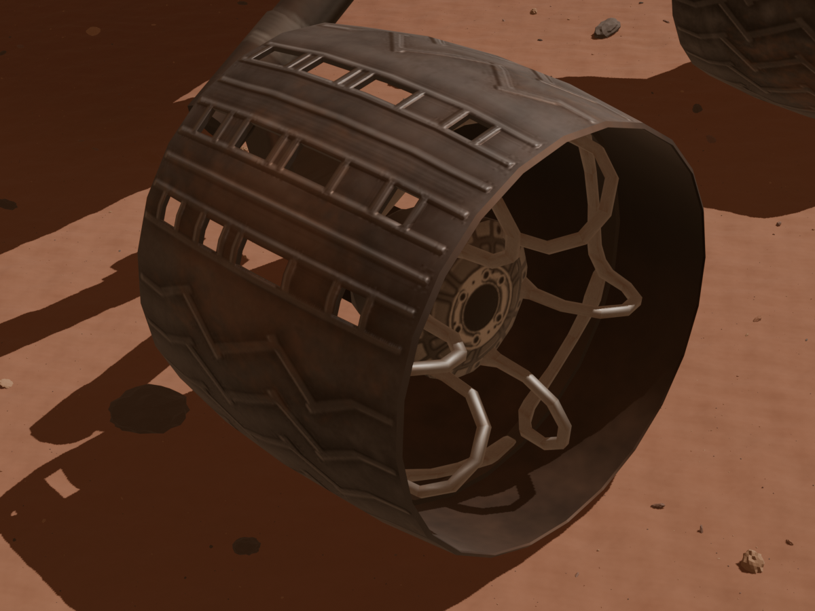
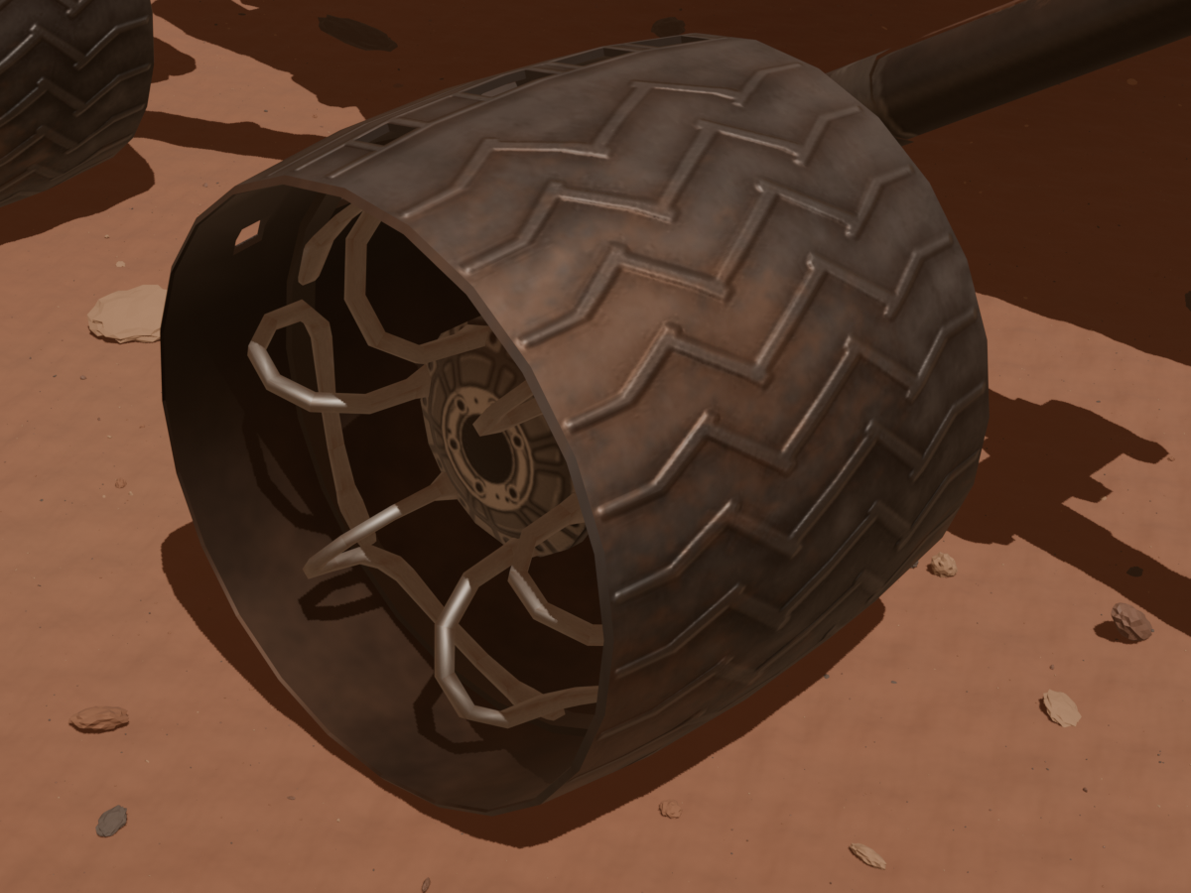
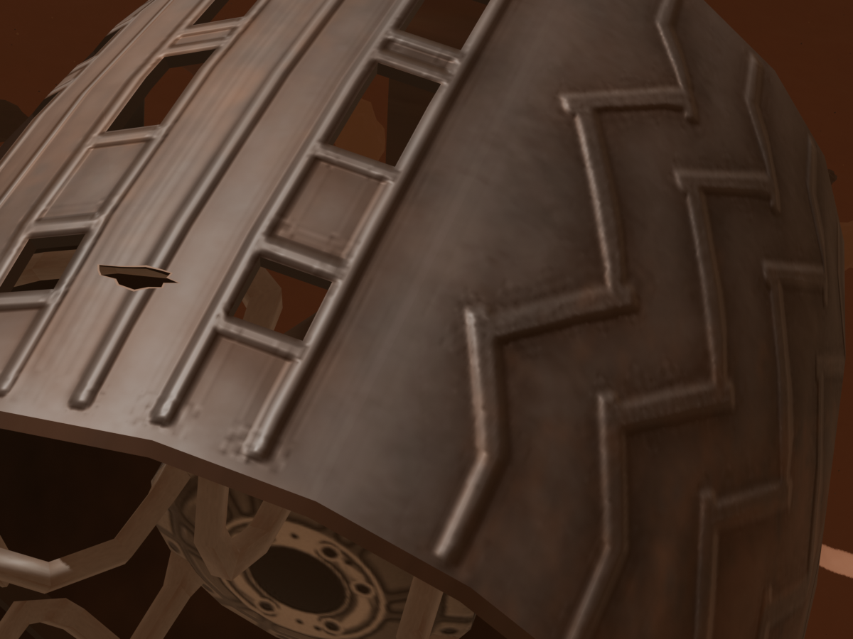
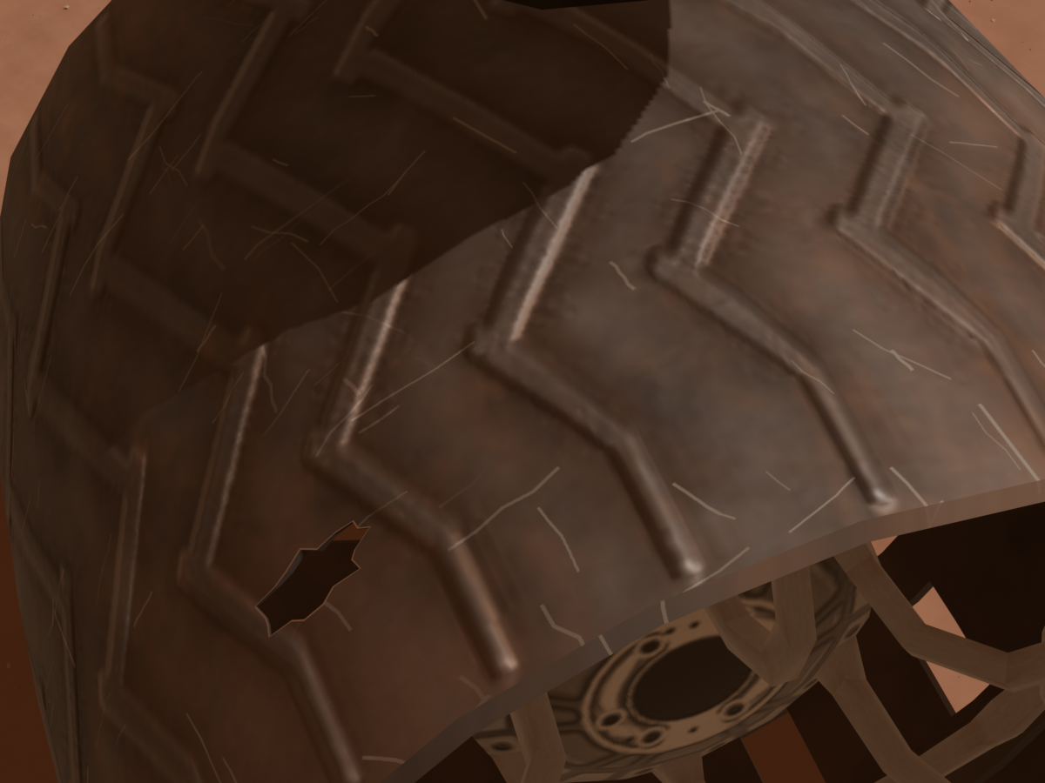
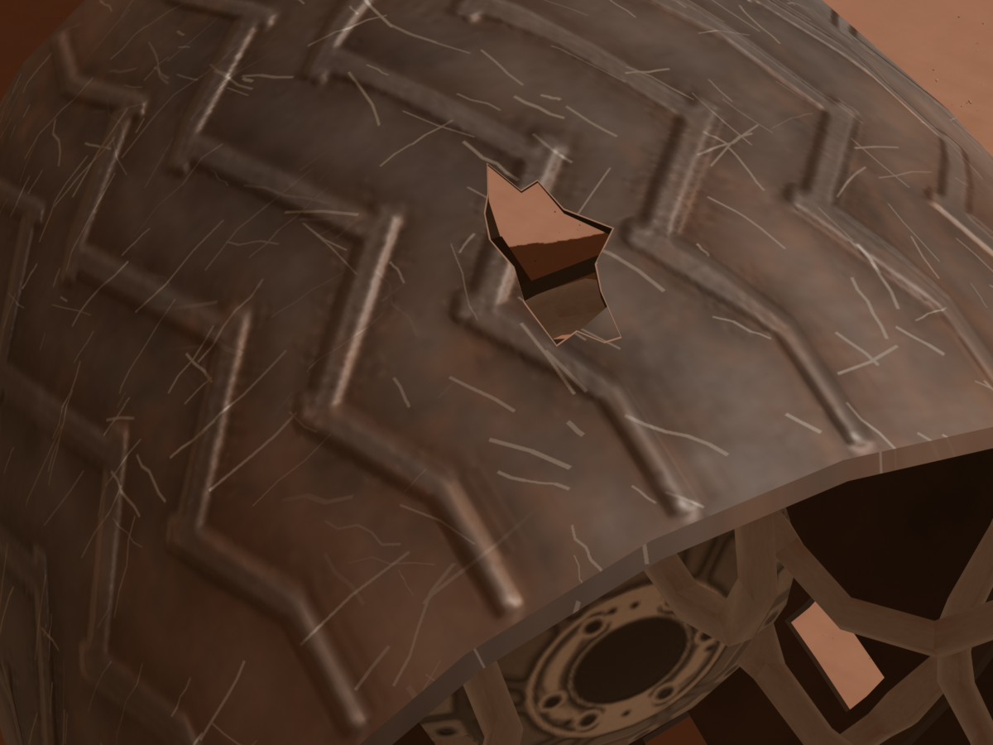
Extra: variations
View A: Overhead (40%)
View C1: Leading (27.5%)
View C2: Trailing (27.5%)
View D: Upper detail (5%)
Small hole: 50%
2.7–4.1 cm
Medium hole: 40%
4.4–6.8 cm
Large hole: 10%
7.3–11.6 cm
Notes:
[Extra slide. Optional remarks for the Q&A, outside the 15-minute presentation.]
The four views have different frequencies: pose A accounts for forty percent, the two oblique views for 27.5 percent each, and the upper detail view for five percent. Among anomalous images only, small holes account for fifty percent, medium holes for forty percent and large holes for ten percent. The ranges in centimeters describe the generated geometry, rather than a classification of mechanical risk. These percentages concern the dataset, rather than the artificial perturbations used to train TinyGLASS.
[LINKING OPTIONS: optional Q&A transition to slide 39 (Loss function ablation). Choose one if relevant.]
Option 1: "I can next explain the segmentation loss experiments."
Option 2: "For more detail on model training, I have an ablation of the segmentation loss."
Option 3: "The following table shows the experiments that motivated the combined loss."
[Supporting sources, not to be read aloud: Thesis, Chapter 3, views and geometric hole sizes.]

Slide 39
Extra: Loss function ablation
U-Net R34: Dice weighting within CE + GDL
Inverse square | Inverse volume | Uniform
64.5 | 57.2 | 62.2
Notes:
[Extra slide. Optional remarks for the Q&A, outside the 15-minute presentation.]
These exploratory experiments motivated the combined loss. Moving from cross-entropy alone to cross-entropy plus Generalized Dice increases mIoU from about 59.5 to 64.5 percent for U-Net ResNet34, and from 69.2 to 75.5 percent for SegFormer. For U-Net, Dice weighting by the inverse squared class volume works better than the alternatives shown. The weights depend on the class pixel counts in the batch and increase the contribution of less represented regions. These results should not be extended automatically to every architecture.
[LINKING OPTIONS: optional Q&A transition to slide 40 (Augmentation and oversampling). Choose one if relevant.]
Option 1: "I also tested augmentation and oversampling."
Option 2: "The loss was one training choice. I also examined data augmentation and sampling."
Option 3: "The next experiments explain the preprocessing and sampling configuration retained for SegFormer."
[Supporting sources, not to be read aloud: Thesis, Chapter 5, loss and Dice-weight ablations.]

Slide 40
Extra: Preprocessing
75.55%
Default test mIoU
SegFormer-B0
CE + GDL
Flips and 90° rotations, training only. Oversampling based on class frequency in the dataset.
Notes:
[Extra slide. Optional remarks for the Q&A, outside the 15-minute presentation.]
For SegFormer, the geometric transformations tested, namely flips and ninety-degree rotations, reduce test mIoU from 75.55 to 66.86 percent. Oversampling also remains below the reference: it reaches 71.02 with inverse-squared Dice weights and 72.90 with uniform weights. Here, uniform and square refer to the Dice loss weights, rather than the sampling probabilities. These experiments support the baseline configuration adopted, but do not demonstrate that every form of augmentation is harmful.
[LINKING OPTIONS: optional Q&A transition to slide 41 (SegFormer IoU per class). Choose one if relevant.]
Option 1: "Next are the quantization results for each class."
Option 2: "I can also break down SegFormer's quantization results by semantic class."
Option 3: "The following table shows which classes change when inference precision is reduced."
[Supporting sources, not to be read aloud: Thesis, Chapter 5, augmentation and oversampling; Chapter 2, sampling definition.]

Slide 41
Extra: SegFormer IoU per class
Class | FP32 | FP16 | INT8 PTQ | INT8 QAT
Bedrock | 71.85 | 71.85 | 71.75 | 72.70
Hole | 78.11 | 78.12 | 78.86 | 79.92
Ridge | 90.20 | 90.20 | 89.94 | 90.96
Rock | 21.77 | 21.75 | 21.67 | 26.15
Rover | 83.03 | 83.03 | 83.33 | 84.60
Sand / Soil | 89.48 | 89.48 | 89.43 | 89.78
Sky | 94.02 | 94.03 | 93.85 | 95.13
Track | 75.96 | 75.97 | 76.01 | 76.19
mIoU | 75.55 | 75.55 | 75.60 | 76.93
S5Mars test mIoU (%)
Extra
Notes:
[Extra slide. Optional explanation, about 40 seconds, outside the 15-minute presentation.]
This table examines the scene segmentation results in more detail. Moving from FP32 to FP16 leaves quality almost unchanged. PTQ also remains very close to the baseline. With QAT, however, every class improves: the largest gains are for Rock, about 4.38 percentage points, and Hole, about 1.81. Overall mIoU increases from 75.55 to 76.93 percent. Rock nevertheless remains the most difficult class. The improvement includes fine-tuning and distillation, so it should not be attributed to reduced precision alone.
[LINKING OPTIONS: optional Q&A transition to slide 42 (Mars-Bench). Choose one if relevant.]
Option 1: "For context, I also considered the Mars-Bench baselines."
Option 2: "The next table places our selected models alongside the published Mars-Bench baselines."
Option 3: "I can add an external benchmark reference, with the evaluation differences kept in mind."
[Details and sources, not to be read aloud.]
All configurations are evaluated on the same 800 S5Mars test images, with 512 x 512 inputs. The eight rows report per-class IoU. mIoU is the mean over the eight annotated categories. Background is excluded from the mean. These are not validation results. INT8 is selective and Conv-only: convolutions are quantized, while other operations remain in floating point. The QAT result reported here is from the final TensorRT engine, rather than the fake-quantization simulation in PyTorch.
FP32, FP16 and PTQ: git object 10f4b53:semantic_segmentation/docs/quantization/onnx_ptq_results.md, subsection 'SegFormer Conv-only sul test set'. The table reports final results on the 800 images, with configurations selected on validation. Original mIoU values: FP32 0.755519684, FP16 0.755540537, PTQ 0.756030374.
QAT: outputs/drive_audit_20261010/report_summaries.json, entry 1Kq-yIOds3hbGkVQPjJ8wi-uDNuhLpPyE, s5mars_qat_modelopt_segformer_b0_int8_conv_only_qdq/results.json, test_metrics.onnx_modelopt_qat_int8_tensorrt. Original mIoU 0.7692888447846535; split test, samples 800. Original Drive file: https://drive.google.com/file/d/1Kq-yIOds3hbGkVQPjJ8wi-uDNuhLpPyE/view . The local copy was used because the connector did not make that file available at the time.
All table values are percentages with two decimal places. Gains are expressed in percentage points and calculated from the source values before display rounding. The experiments include differences in training and backend, so they do not isolate the effect of bit width alone.

Slide 42
Extra: Mars-Bench
Model | S5Mars mIoU (%) | Total parameters (M)
SegFormer-B0 (this thesis) | 75.55 | 3.72
DeepLabV3+ / MobileNetV2 (this thesis) | 64.07 | 4.38
U-Net / ResNet34 (Mars-Bench) | 17.77 | ≈ 24.4
DeepLabV3+ / ResNet34 (Mars-Bench) | 16.74 | ≈ 22.4
SegFormer / ResNet34 (Mars-Bench) | 16.06 | ≈ 21.9
DPT / ViT-Base (Mars-Bench) | 18.06 | ≈ 137.8
≈ Total parameter estimates from released configurations.
54 / 54
Notes:
[Extra slide, outside the 15-minute presentation. Optional remarks, about 45–55 seconds.]
This table places the two selected trade-offs from the thesis alongside the public Mars-Bench baselines. SegFormer-B0 with QAT prioritizes quality, while DeepLabV3+ MobileNetV2 with QAT prioritizes cost. Both have fewer than five million parameters. The Mars-Bench counts are estimates of total parameters, including frozen encoders. The scores come from the authors' leaderboard, but the CSV does not document the corresponding protocol. We therefore cannot attribute the mIoU difference to architecture alone or interpret it as a controlled ranking.
[LINKING OPTIONS: optional Q&A transition to slide 43 (Full quantization results). Choose one if relevant.]
Option 1: "Returning to our experiments, here are all precision configurations."
Option 2: "Within our own protocol, we can compare the full set of deployment configurations."
Option 3: "The complete quantization table gives more detail on these accuracy and efficiency results."
[Sources and method, not to be read aloud.]
Thesis, Chapters 2 and 5: SegFormer-B0 QAT mIoU 76.93%, 3.72M parameters; DeepLabV3+ MobileNetV2 QAT mIoU 65.63%, 4.38M parameters. Quantization changes weight precision, rather than the reference architectural parameter count.
[5] M. Purohit et al., Mars-Bench: A Benchmark for Evaluating Foundation Models for Mars Science Tasks, NeurIPS Datasets and Benchmarks, 2025. https://arxiv.org/abs/2510.24010 . The numerical values reported here come from the public leaderboard CSV, rather than a visual estimate from the violin plots: https://huggingface.co/spaces/Mirali33/Mars-Bench/blob/main/data/segmentation.csv . S5Mars IoU: U-Net 0.1777; DeepLabV3+ 0.1674; SegFormer 0.1606; DPT 0.1806. The CSV does not specify the training regime, checkpoint selection or seed aggregation. The public code averages per-class IoUs. Before a controlled comparison, training, preprocessing, class encoding and the handling of unannotated pixels must be aligned.
Parameter estimates: public configurations at commit 8df5c160528d64778a53afaf07a63fba305f65b9, https://github.com/kerner-lab/Mars-Bench/tree/8df5c160528d64778a53afaf07a63fba305f65b9/marsbench/configs/model/segmentation ; implementations https://github.com/kerner-lab/Mars-Bench/tree/8df5c160528d64778a53afaf07a63fba305f65b9/marsbench/models/segmentation . U-Net, DeepLabV3+ and SegFormer use ResNet34 in the released files. Do not assume that the SegFormer in that code is MiT-B0. DPT uses tu-vit_base_patch16_224.augreg_in21k.
Architectural calculation using SMP v0.5.0 defaults and 9 output channels: https://smp.readthedocs.io/en/v0.5.0/models.html . U-Net approximately 24.438M; DeepLabV3+ approximately 22.440M; SegFormer approximately 21.879M; DPT approximately 137.808M. These are estimates based on the configurations, rather than counts taken from the replica checkpoints. They include frozen weights and affine normalization parameters, and exclude buffers.
DPT clarification: SMP v0.5.0's TimmViTEncoder retains the ImageNet-21k classification head registered by the ViT. The timm configuration confirms 21,843 classes: https://huggingface.co/timm/vit_base_patch16_224.augreg_in21k/blob/main/config.json . The segmentation path does not use this head, but the registered total includes it. Removing it would reduce the count to about 121.0M. The displayed estimate remains about 137.8M for the model as constructed.
Sources consulted on 20 October 2026.

Slide 43
Extra: Full Quantization results
Precision | Test mIoU (%) | Latency (ms) | Energy (mJ/image)
U-Net / ResNet34
FP32 | 64.55 | 16.30 | 1213.08
FP16 | 64.55 | 9.19 | 659.76
PTQ INT8 | 64.51 | 5.82 | 304.10
QAT INT8 | 65.24 | 4.81 | 231.42
U-Net / MobileNetV2
FP32 | 64.57 | 11.87 | 878.80
FP16 | 64.61 | 8.16 | 523.07
PTQ INT8 | 61.55 | 4.17 | 199.96
QAT INT8 | 65.00 | 3.57 | 162.66
DeepLabV3 / ResNet34
FP32 | 73.79 | 56.27 | 3977.25
FP16 | 73.79 | 14.03 | 1016.14
PTQ INT8 | 73.55 | 7.19 | 455.34
QAT INT8 | 73.62 | 8.65 | 523.71
Precision | Test mIoU (%) | Latency (ms) | Energy (mJ/image)
DeepLabV3+ / MobileNetV2
FP32 | 64.07 | 8.84 | 653.72
FP16 | 64.07 | 6.03 | 377.88
PTQ INT8 | 59.14 | 4.02 | 159.19
QAT INT8 | 65.63 | 3.01 | 115.34
SegFormer-B0
FP32 | 75.55 | 11.88 | 835.72
FP16 | 75.55 | 7.17 | 432.07
PTQ INT8 | 75.60 | 5.92 | 327.99
QAT INT8 | 76.93 | 5.66 | 291.76
Highest test mIoU
SegFormer-B0 QAT: 76.93%
Lowest GPU energy per image
DeepLabV3+ MV2 QAT: 115.34 mJ
S5Mars test. NVIDIA T4, batch 1.
INT8 uses selective mixed precision (SegFormer: Conv-only).
Notes:
[Extra slide. Optional remarks for the Q&A, outside the 15-minute presentation.]
The full table shows that the benefit of reduced precision depends on the configuration. QAT SegFormer achieves the highest mIoU, while QAT DeepLabV3+ MobileNetV2 has the lowest energy consumption. There are exceptions to a general preference for QAT, however: DeepLabV3 ResNet34 with PTQ has lower latency and energy consumption than its QAT version. The execution backends also differ, so we are comparing complete deployment configurations. INT8 is selective and, for SegFormer, limited to convolutions. Energy refers to the GPU during inference and is expressed here in millijoules per image.
[LINKING OPTIONS: optional Q&A transition to slide 44 (Full anomaly detection results). Choose one if relevant.]
Option 1: "I can now expand the wheel inspection results."
Option 2: "Let's return to the inspection branch and its image-level metrics."
Option 3: "The next table contains the full anomaly detection results."
[Supporting sources, not to be read aloud: Thesis, Chapter 5, full quantization table; Chapter 2, deployment configurations.]

Slide 44
Extra: Anomaly Detection Results
Model | Image AUROC (%) | Image AP (%)
PatchCore-S | 79.28 | 77.49
PatchCore-L | 86.43 | 88.63
EfficientAD-S | 66.50 | 64.74
SuperSimpleNet | 82.72 | 86.08
TinyGLASS-384 | 77.52 | 79.28
TinyGLASS-512 | 77.33 | 81.12
Image-level metrics, pose-A test, 808 images
Notes:
[Extra slide. Optional remarks for the Q&A, outside the 15-minute presentation.]
This is the full image-level evaluation on the 808 test observations in pose A, corresponding to 404 normal-damaged pairs. PatchCore-L ranks first for both AUROC, at 86.43 percent, and Average Precision, at 88.63 percent. SuperSimpleNet is second, while the two TinyGLASS variants have very similar AUROC values. These metrics describe the ordering of scores across thresholds. For operational use, thresholds would need to be selected on validation data, with false alarms and missed damage measured on an independent test set.
[LINKING OPTIONS: optional Q&A transition to slide 45 (Full localization results). Choose one if relevant.]
Option 1: "The corresponding localization results are shown next."
Option 2: "I can also show the complete pixel-level and region-level metrics."
Option 3: "Next, I will examine how precisely these models locate the damage."
[Supporting sources, not to be read aloud: Thesis, Chapter 6, full detection results table.]

Slide 45
Extra: Localization Results
Model | Pixel AUROC (%) | Pixel AP (%) | AUPRO @0.05 (%) | AUPRO @0.10 (%) | AUPRO @0.30 (%)
PatchCore-S | 99.78 | 41.05 | 94.93 | 97.35 | 99.10
PatchCore-L | 99.43 | 42.89 | 82.90 | 89.36 | 95.44
EfficientAD-S | 96.36 | 9.00 | 58.45 | 70.36 | 84.98
SuperSimpleNet | 96.97 | 19.10 | 71.62 | 78.58 | 87.53
TinyGLASS-384 | 97.21 | 25.48 | 73.93 | 81.10 | 90.24
TinyGLASS-512 | 97.92 | 27.59 | 76.54 | 83.56 | 92.01
Pixel and region metrics, same pose-A test split
AUPRO is normalized up to the false-positive-rate limit stated in each column.
Notes:
[Extra slide. Optional remarks for the Q&A, outside the 15-minute presentation.]
The spatial metrics reveal differences from image-level detection alone. PatchCore-L achieves the highest Pixel AP, at 42.89 percent, while PatchCore-S leads in Pixel AUROC and AUPRO. AUPRO measures the coverage of anomalous regions as the false-positive rate varies, and is normalized up to the limit shown in each column. With small defects, even a low false-positive rate can correspond to many incorrectly flagged pixels. This is why very high Pixel AUROC can coexist with limited precision. AP, AUPRO and qualitative maps should therefore be considered together.
[LINKING OPTIONS: optional Q&A transition to slide 46 (Normal vs damaged wheel). Choose one if relevant.]
Option 1: "A matched image pair makes these outputs concrete."
Option 2: "The next example shows the outputs for the same wheel with and without a perforation."
Option 3: "I can illustrate the image score and anomaly map using a normal and damaged observation."
[Supporting sources, not to be read aloud: Thesis, Chapter 4, metrics; Chapter 6, full localization table.]

Slide 46
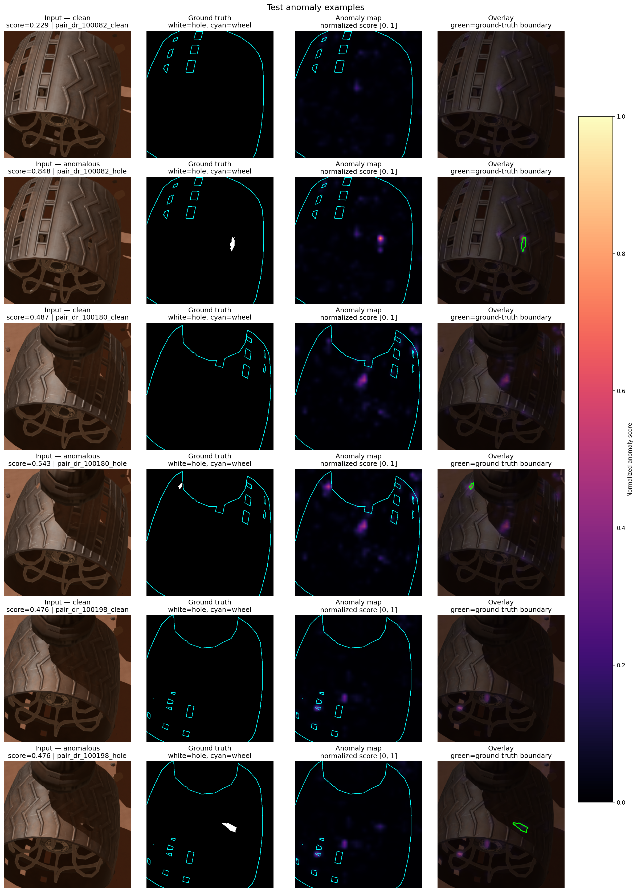
Extra: Normal vs damaged wheel
TinyGLASS-512
RGB image
Ground truth
Anomaly map
Normal
0.229
Image score
Damaged
0.848
Image score
55/25
Notes:
[Extra slide. Optional explanation for the Q&A, about 35–45 seconds, outside the 15-minute presentation.]
This example compares the same wheel observation with and without a synthetic perforation. The scene, viewpoint and surface appearance are matched. The normal image receives an anomaly score of 0.229, while the damaged image receives 0.848.
The middle column shows the ground truth: white marks the hole, and cyan outlines the target wheel. The last column shows the model's continuous anomaly map. In the damaged observation, a stronger response appears near the annotated hole. The score describes the entire image, while the map shows the spatial response.
These are normalized anomaly scores, rather than probabilities. This pair illustrates the model's behavior on one example and does not summarize performance across the test set.
[LINKING OPTIONS: optional Q&A transition to slide 47 (U-Net). Choose one if relevant.]
Option 1: "I also have the architecture diagrams, beginning with U-Net."
Option 2: "If architecture details are useful, I can start with U-Net."
Option 3: "For the segmentation models, the next diagram shows how U-Net works."
[Configuration and sources, not to be read aloud.]
Recorded test pair: pair_dr_100082_clean and pair_dr_100082_hole, synthetic pose A test set. Model: TinyGLASS with frozen ResNet18, 512 × 512 input, layer3 feature grid, Gaussian smoothing σ=1. The final TG-512 configuration in the thesis uses σ=4. These maps are from the recorded σ=1 example and must not be presented as the σ=4 maps. The image score is obtained before map smoothing. No classification threshold or predicted binary mask is shown.

Slide 47
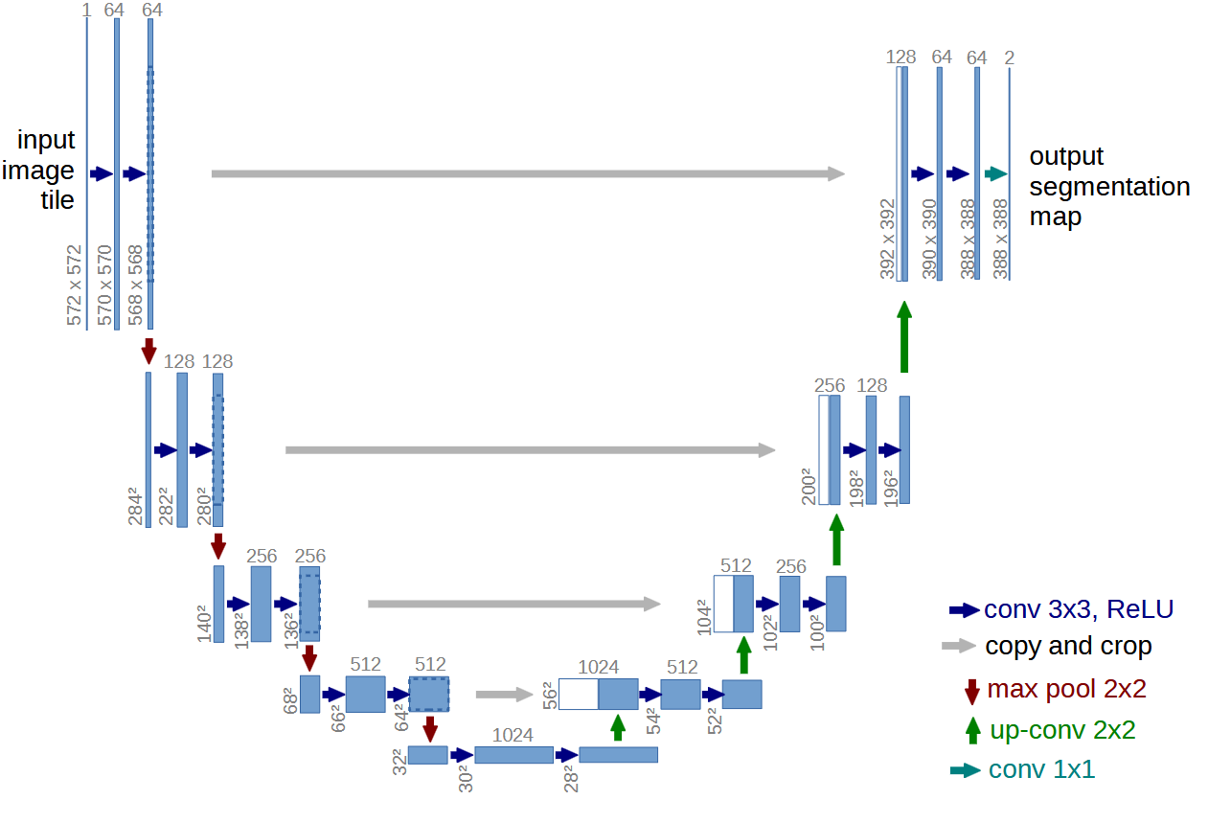
Extra: U-Net
Notes:
[Extra slide. Optional remarks for the Q&A, outside the 15-minute presentation.]
U-Net combines a contracting path, which extracts semantic information, with a decoder that recovers spatial resolution. Connections between corresponding levels help preserve details that are useful at class boundaries. This is the original figure for the model family. In the thesis experiments, ResNet34 or MobileNetV2 replaces the encoding path. The comparison therefore also assesses how much we can reduce the encoder's size while preserving quality.
[LINKING OPTIONS: optional Q&A transition to slide 48 (DeepLabV3). Choose one if relevant.]
Option 1: "The next architecture is DeepLabV3."
Option 2: "I can compare that structure with DeepLabV3's approach to segmentation."
Option 3: "Another architecture evaluated in the thesis was DeepLabV3."
[Supporting sources, not to be read aloud: Thesis, Chapter 2, U-Net; original figure from reference [6].]

Slide 48
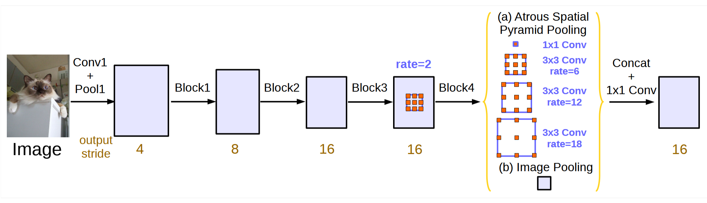
Extra: DeepLabV3
Notes:
[Extra slide. Optional remarks for the Q&A, outside the 15-minute presentation.]
DeepLabV3 uses dilated convolutions to increase the receptive field without further reducing feature resolution. The ASPP module combines branches with different dilation rates and a global context contribution. This helps describe objects and regions at different scales. In the thesis, I evaluated the configuration with ResNet34. Its good segmentation performance needs to be considered alongside its higher inference cost.
[LINKING OPTIONS: optional Q&A transition to slide 49 (DeepLabV3+). Choose one if relevant.]
Option 1: "The next diagram shows the DeepLabV3+ variant."
Option 2: "DeepLabV3+ extends this design with a decoder."
Option 3: "I can now explain how DeepLabV3+ combines context with higher-resolution features."
[Supporting sources, not to be read aloud: Thesis, Chapter 2, DeepLabV3; original figure from reference [7].]

Slide 49
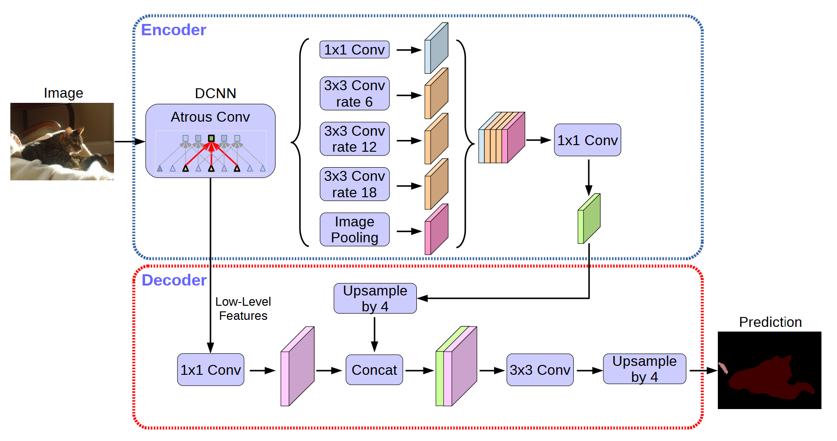
Extra: DeepLabV3+
Notes:
[Extra slide. Optional remarks for the Q&A, outside the 15-minute presentation.]
DeepLabV3+ retains DeepLab's multiscale feature extraction and adds a decoder that combines semantic context with higher-resolution features. Separable convolutions help contain the cost. The figure describes the general architecture. In the experiments, I use MobileNetV2 as the backbone. This configuration is particularly interesting for efficiency: with QAT, it has the lowest GPU energy per image among the segmentation models reported.
[LINKING OPTIONS: optional Q&A transition to slide 50 (SegFormer). Choose one if relevant.]
Option 1: "I will now move on to SegFormer."
Option 2: "SegFormer provides an alternative built around a transformer encoder."
Option 3: "The next diagram shows SegFormer's encoder and decoder."
[Supporting sources, not to be read aloud: Thesis, Chapter 2, DeepLabV3+; original figure from reference [8].]

Slide 50
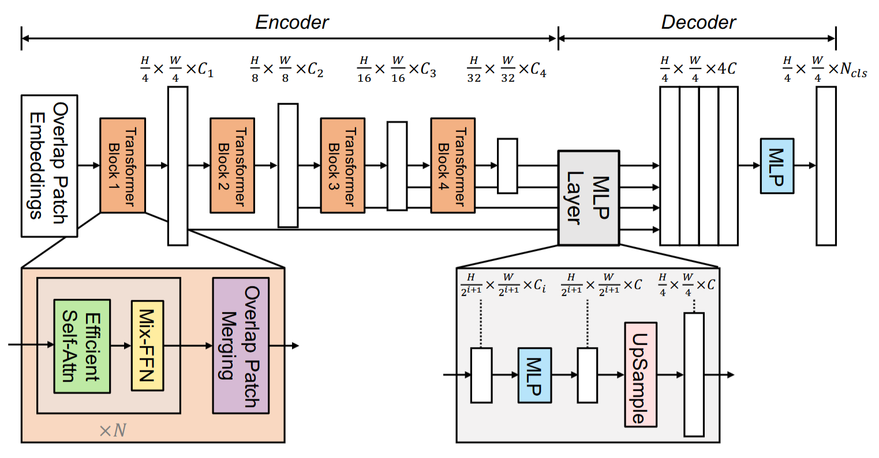
Extra: SegFormer
Notes:
[Extra slide. Optional remarks for the Q&A, outside the 15-minute presentation.]
SegFormer uses a hierarchical transformer encoder, which produces features at multiple resolutions, and a relatively simple MLP decoder to combine them. The B0 variant keeps the model compact, with about 3.7 million parameters. In our comparison, it offers the highest test mIoU and better generalization between the two MarsSeg domains than the CNNs considered. The quantization tested remains selective, however: attention, linear projections and some other operations do not all become INT8.
[LINKING OPTIONS: optional Q&A transition to slide 51 (LCNet). Choose one if relevant.]
Option 1: "Another compact architecture in the study is LCNet."
Option 2: "LCNet is the next lightweight model in the comparison."
Option 3: "The following diagram shows LCNet's approach to lightweight segmentation."
[Supporting sources, not to be read aloud: Thesis, Chapter 2, SegFormer; original figure from reference [9].]

Slide 51
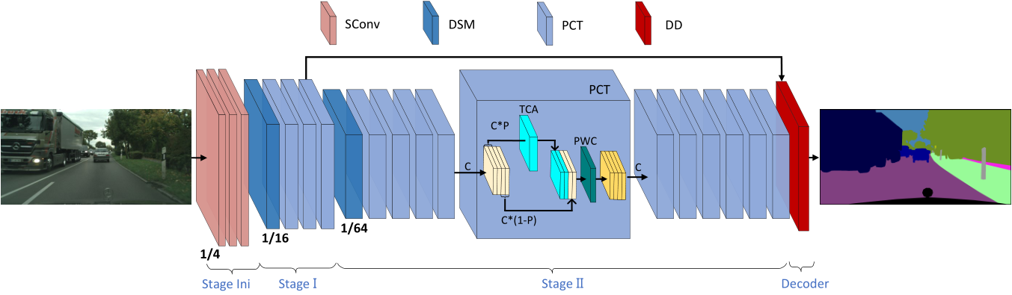
Extra: LCNet
Notes:
[Extra slide. Optional remarks for the Q&A, outside the 15-minute presentation.]
LCNet is designed for lightweight segmentation. It restricts some transformations to selected channels, aiming to preserve contextual information with fewer parameters. I tested configurations (3,7) and (3,11), with about 0.51 and 0.73 million parameters respectively. They are trained from scratch and for more epochs than the other models. The results show that, in the configurations tested, this high degree of compactness comes with lower mIoU.
[LINKING OPTIONS: optional Q&A transition to slide 52 (PatchCore). Choose one if relevant.]
Option 1: "Turning to damage inspection, I will start with PatchCore."
Option 2: "I can now switch to the anomaly detection architectures."
Option 3: "The inspection architecture diagrams begin with PatchCore and its memory bank."
[Supporting sources, not to be read aloud: Thesis, Chapter 2, LCNet; original figure from reference [10].]

Slide 52
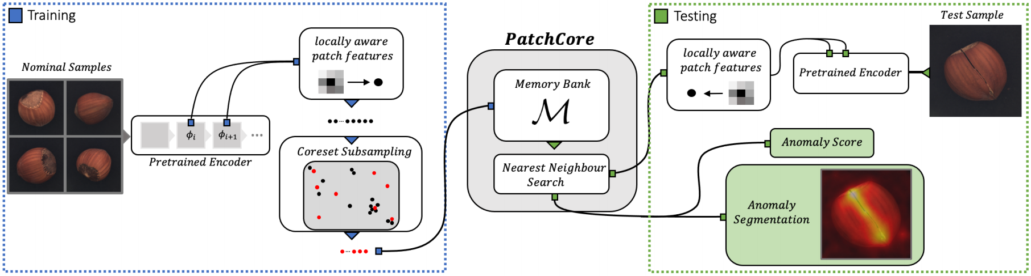
Extra: PatchCore
Notes:
[Extra slide. Optional remarks for the Q&A, outside the 15-minute presentation.]
In PatchCore, a fixed pretrained extractor produces descriptors of normal patches. A representative subset forms the memory bank. During inference, the distance to the nearest descriptors generates the local scores and the image score. In the thesis, the bank contains fifty thousand descriptors for both versions. Cost also depends on the number of patches to compare: the Small configuration uses a denser grid and, despite its smaller backbone, is slower than the Large configuration.
[LINKING OPTIONS: optional Q&A transition to slide 53 (EfficientAD). Choose one if relevant.]
Option 1: "Let's now look at EfficientAD."
Option 2: "EfficientAD offers a different way to learn normal appearance."
Option 3: "The next architecture uses a teacher and a student to identify anomalous responses."
[Supporting sources, not to be read aloud: Thesis, Chapters 4 and 6, PatchCore; original figure from reference [16].]

Slide 53
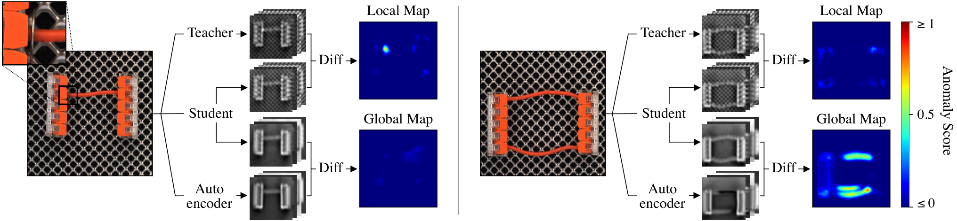
Extra: EfficientAD
Notes:
[Extra slide. Optional remarks for the Q&A, outside the 15-minute presentation.]
EfficientAD combines a fixed teacher with a student trained on normal images. If the student does not reproduce the teacher's features well in a region, that difference contributes to the anomaly map. An autoencoder adds a check on global context, and the contributions are calibrated on normal validation data. The figure illustrates the general method, including structural and logical anomalies. Our application instead concerns perforations and does not reproduce all the scenarios in the original work.
[LINKING OPTIONS: optional Q&A transition to slide 54 (SuperSimpleNet). Choose one if relevant.]
Option 1: "The next model is SuperSimpleNet."
Option 2: "SuperSimpleNet takes another approach using artificial training anomalies."
Option 3: "I can now show SuperSimpleNet's detection and localization branches."
[Supporting sources, not to be read aloud: Thesis, Chapter 4, EfficientAD-S; original figure from reference [17].]

Slide 54
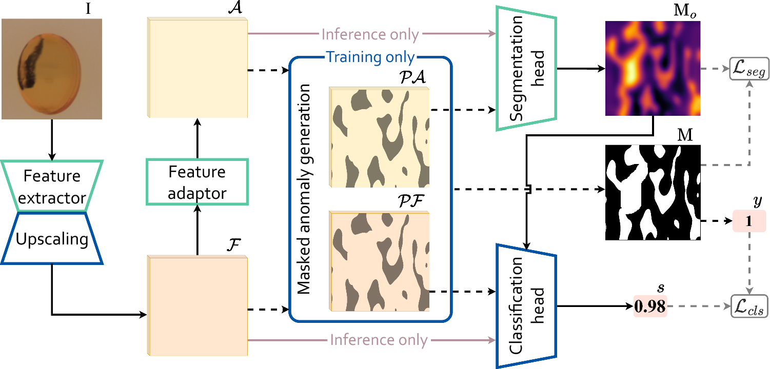
Extra: SuperSimpleNet
Notes:
[Extra slide. Optional remarks for the Q&A, outside the 15-minute presentation.]
The diagram shows feature extraction and the creation of artificial anomalies during training. The model jointly learns to produce a map and an image score. The general formulation supports multiple supervision settings, but in the thesis I use only normal data and synthetic feature perturbations. The WideResNet50 backbone is fixed. For the main result, the image score comes from the mean of the highest one percent of values in the raw map, rather than just the classification head's output.
[LINKING OPTIONS: optional Q&A transition to slide 55 (TinyGLASS). Choose one if relevant.]
Option 1: "TinyGLASS is the next compact inspection model."
Option 2: "TinyGLASS also uses artificial anomalies, with a compact backbone."
Option 3: "Let's now look at how TinyGLASS produces its predictions."
[Supporting sources, not to be read aloud: Thesis, Chapter 4, SuperSimpleNet; figure from the extended formulation, reference [19].]

Slide 55
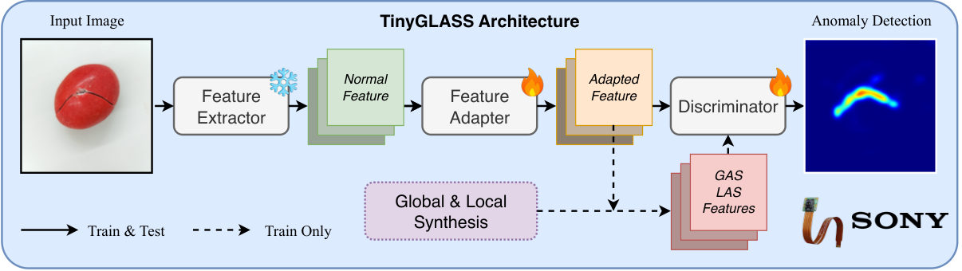
Extra: TinyGLASS
Notes:
[Extra slide. Optional remarks for the Q&A, outside the 15-minute presentation.]
TinyGLASS combines local anomalies synthesized in image space with guided perturbations in feature space. These mechanisms are used during training. Inference retains a direct prediction path. This is the original figure. In our implementation, the ResNet18 backbone is fixed, and I use feature pooling without the separate trainable adapter shown in the diagram. The 384- and 512-pixel variants also differ in their feature grids and smoothing. Their comparison therefore concerns complete configurations, rather than the effect of resolution alone.
[LINKING OPTIONS: optional Q&A transition to slide 56 (TinyGLASS ablation). Choose one if relevant.]
Option 1: "The ablation results explain how these settings were chosen."
Option 2: "The next slide examines TinyGLASS's training and spatial configuration choices."
Option 3: "I can now show how the selected TinyGLASS design choices affect the results."
[Supporting sources, not to be read aloud: Thesis, Chapters 4 and 6, TinyGLASS; original figure from reference [20], CC BY 4.0.]

Slide 56
Extra: TinyGLASS ablation
Pose A, 720 × 720 crop
Training perturbations
Resolution and smoothing
384 × 384 input, 32 × 32 grid, σ = 4
Hole LAS: 70/25/5% small/medium/large
LAS setting | Image AUROC | Pixel AP
Texture | 66.78 | 6.97
Hole (initial) | 69.72 | 11.46
Hole (50/40/10%) | 72.04 | 14.71
Hole (70/25/5%) | 72.55 | 14.67
Input (px) | Grid | σ | Image AUROC | Pixel AP
256×256 | 32×32 | 1 | 72.55 | 15.72
384×384 | 48×48 | 1 | 77.52 | 25.48
512×512 | 64×64 | 1 | 73.81 | 23.55
512×512 | 32×32 | 1 | 77.33 | 27.01
512×512 | 32×32 | 4 | 77.33 | 27.59
Hole-like LAS improves localization.
56/25
Notes:
[Extra slide. Optional explanation for the Q&A, about 50–60 seconds, outside the 15-minute presentation.]
This slide summarizes two groups of TinyGLASS ablations. On the left, the input resolution, feature grid and smoothing are fixed. Replacing texture perturbations with hole-like perturbations increases test Pixel AP from 6.97 to 11.46 percent. Adjusting the hole-size distribution brings it to about 14.7 percent. Giving more weight to small holes slightly improves detection, but does not improve test Pixel AP compared with the 50/40/10 distribution. We kept 70/25/5 based on validation performance.
On the right, increasing the input from 256 to 384 pixels improves both metrics, while simply increasing it to 512 pixels with the dense grid does not. At 512 pixels, pooling to a 32 by 32 grid improves localization. Increasing smoothing from sigma one to sigma four then raises Pixel AP from 27.01 to 27.59 percent, with the same Image AUROC. This is because the image score is computed before map smoothing.
[LINKING OPTIONS: optional wrap-up for this answer. Choose one.]
Option 1: "These experiments explain the TinyGLASS settings retained in the comparison."
Option 2: "I hope this clarifies the role of the training and smoothing choices."
Option 3: "I can return to the main comparison if further detail would be useful."
[Experimental context and sources, not to be read aloud.]
All visible results are percentages on the synthetic pose-A test split, using the fixed 720 × 720 crop and the original data splits. They are selected experiments, not a complete factorial ablation or a sequence that isolates every training change. Configuration and checkpoint selection uses validation, rather than choosing the highest test metric.
Left table: 256 × 256 input, 32 × 32 feature grid, σ=4. Texture/local: test Image AUROC 66.78, Pixel AP 6.97. Hole/initial: 69.72, 11.46. Hole/50-40-10: 72.04, 14.71. Hole/70-25-5: 72.55, 14.67. The probabilities describe small, medium and large LAS training perturbations, not the proportions of damaged Blender images. The 70/25/5 configuration has validation Image AUROC 83.74 and Pixel AP 15.18, compared with 83.35 and 14.40 for 50/40/10. Small-hole test Pixel AP decreases from 7.21 to 6.84, so the frequency change does not resolve the small-defect problem. All visible training variants omit the hypersphere constraint and retain local GAS constraints. In the earlier 900 × 900 crop experiment, removing the hypersphere constraint changes test Image AUROC from 56.33 to 63.81 and Pixel AP from 1.41 to 7.32. This earlier crop comparison is not mixed into the on-slide table.
Right table: fixed LAS hole probabilities 70/25/5. The 256 × 256 and 384 × 384 rows use alignment to the layer2 grid. At 512 × 512, both the layer2 64 × 64 grid and the layer3 32 × 32 grid are shown. Features from both layer2 and layer3 remain in the model; grid size denotes alignment/pooling resolution, rather than excluding an extractor stage. Smoothing variants of a checkpoint share their image score and Image AUROC. The 27.01 to 27.59 change is 0.58 percentage points, using displayed rounded values. The 384 × 384, 48 × 48, σ=1 row is TG-384. The 512 × 512, 32 × 32, σ=4 row is TG-512. Best image and pixel values are emphasized independently within each table.
The thesis also evaluates image-score aggregation on the initial hole-LAS checkpoint. Maximum aggregation obtains validation Image AUROC 80.60 and Image AP 59.51. The mean of the top three responses gives 80.55 and 58.91; wider averages and the tested quantiles perform worse. The final configuration therefore keeps the maximum.
Authoritative source: Daniele Venturini, Lightweight Scene Understanding and Synthetic Data-Driven Damage Inspection for Martian Rovers, Chapter 6, thesis/latex/Chapters/6 Evaluation of Synthetic Damage Inspection.tex. Training table: label tab:damage-tinyglass-training-ablation. Spatial table: label tab:damage-tinyglass-spatial-ablation. The complete tables also report validation and additional spatial settings. Method reference: TinyGLASS, reference [20] in the presentation bibliography.

Slide 57
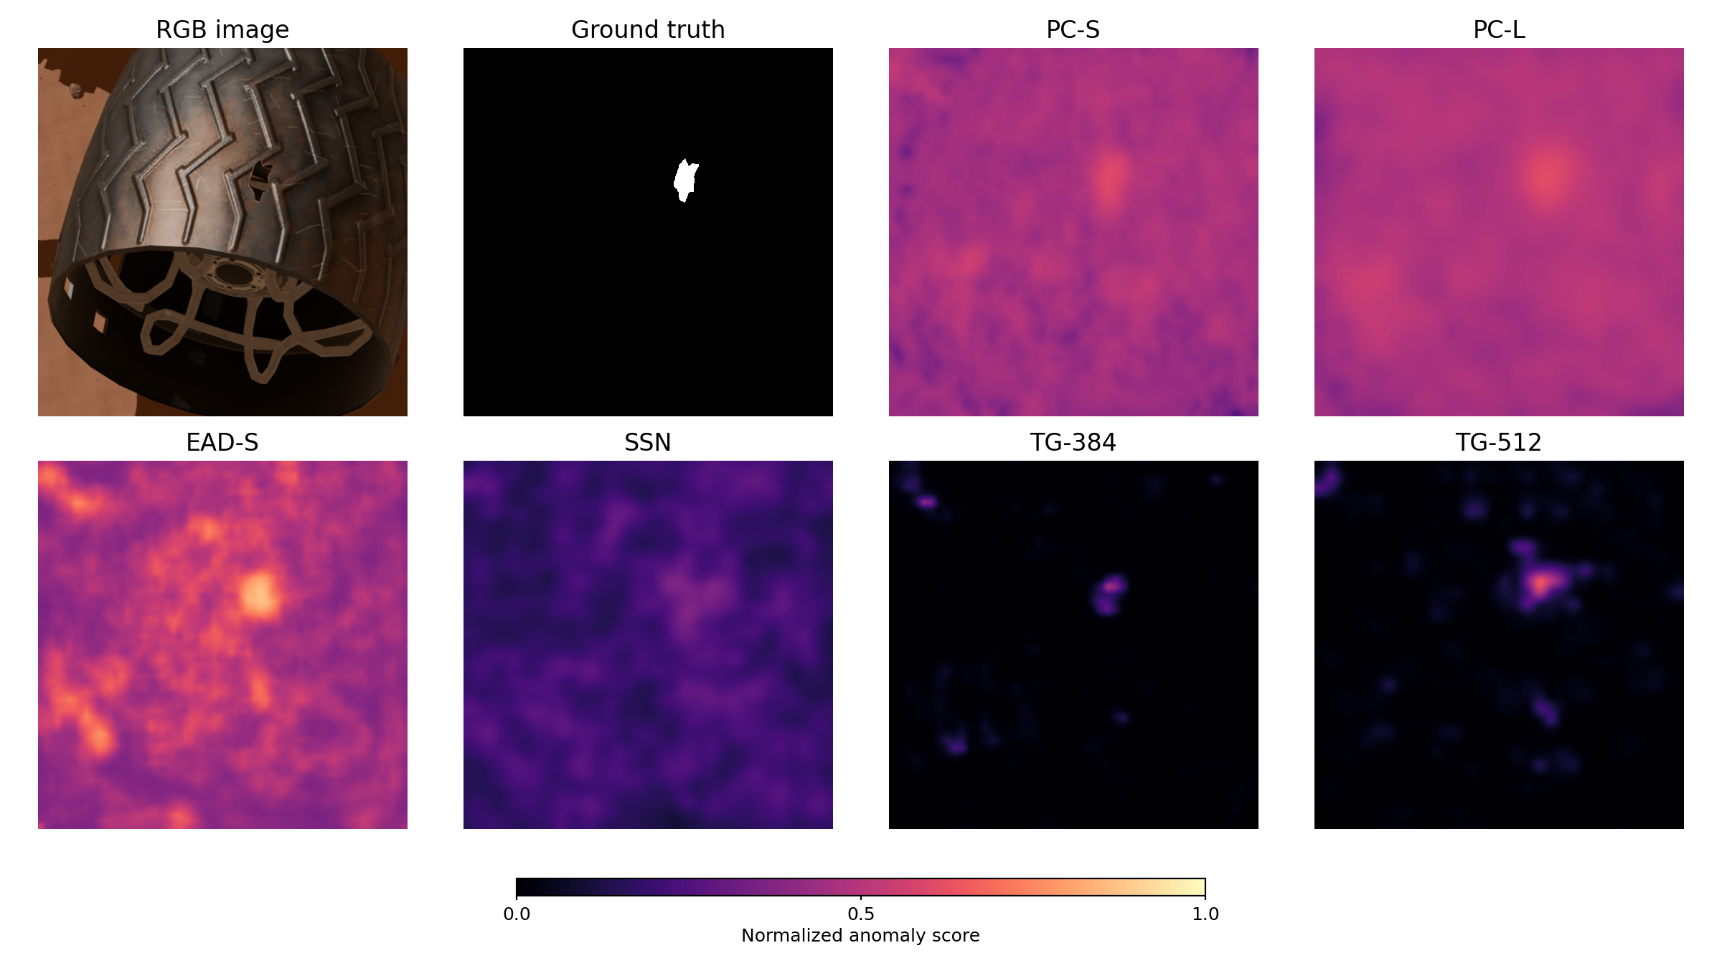
Extra: Spatial anomaly maps
Same synthetic observation, six reference configurations
RGB image
Ground-truth mask
PatchCore-S
PatchCore-L
EfficientAD-S
SuperSimpleNet
TinyGLASS-384
TinyGLASS-512
Normalized anomaly score
0
0.5
1
57/25
Notes:
[Extra slide. Optional explanation for the Q&A, about 40–50 seconds, outside the 15-minute presentation.]
This slide compares the spatial anomaly maps of all six reference configurations on the same damaged wheel image. The RGB image and the ground-truth mask provide the reference, with the white region marking the perforation. Brighter colors in each map indicate a higher normalized anomaly response.
The maps show differences in how the models distribute their responses. In this example, PatchCore and EfficientAD produce broader responses over the wheel, while TinyGLASS concentrates its response more closely around the hole. SuperSimpleNet also responds near the defect, but more diffusely than the TinyGLASS configurations.
These are continuous maps. Producing a binary damage mask would require an appropriate threshold for each model. This single example illustrates spatial behavior, while the localization metrics summarize performance over the evaluation set.
[LINKING OPTIONS: optional wrap-up for this answer. Choose one.]
Option 1: "That completes the qualitative comparison across the six configurations."
Option 2: "I can return to the quantitative localization results if useful."
Option 3: "These maps illustrate the different spatial responses behind the reported metrics."
[Sources and interpretation, not to be read aloud.]
Source figure: thesis/latex/Images/damage_model_prediction_comparison.png. Thesis: Daniele Venturini, Lightweight Scene Understanding and Synthetic Data-Driven Damage Inspection for Martian Rovers, Chapter 6, thesis/latex/Chapters/6 Evaluation of Synthetic Damage Inspection.tex, figure label fig:damage-model-map-comparison and adjacent qualitative discussion.
The six reference configurations are PC-S, PC-L, EAD-S, SSN, TG-384 and TG-512. The labels are expanded on the slide. The ground-truth panel is an annotated binary perforation mask. The model panels are normalized continuous anomaly maps and are not thresholded prediction masks. The displayed scale is [0,1], and map values are not calibrated probabilities. Do not infer a controlled cross-model probability comparison from the brightness alone.
This qualitative image does not replace the detection or localization results over the complete evaluation set. The broader PatchCore/EfficientAD responses and the more concentrated TinyGLASS responses are observations on this example. No per-image numerical scores or unrecorded thresholds are added.

Slide 58
Extra: SSN pose and crop
Metric (%) | All poses No crop | All poses Crop | Pose A No crop | Pose A Crop
Val Image AUROC | 56.63 | 59.15 | 77.64 | 84.07
Val Pixel AP | 8.77 | 11.62 | 9.18 | 18.44
Test Image AUROC | 54.05 | 54.95 | 65.26 | 69.74
Test Pixel AP | 8.33 | 11.40 | 7.27 | 19.49
Pose A: test Pixel AP rises from 7.27% to 19.49%
58/25
Notes:
[Extra slide. Optional explanation for the Q&A, about 45–60 seconds, outside the 15-minute presentation.]
This table compares four SuperSimpleNet acquisition settings at a 256 by 256 input resolution, before changing the image-score formulation. Pose A with cropping achieves the highest validation and test values in this comparison.
The clearest improvement is in localization: within pose A, cropping raises test Pixel AP from 7.27 to 19.49 percent, a gain of 12.22 percentage points. For all poses, cropping improves test Image AUROC only slightly, from 54.05 to 54.95 percent. This supports the controlled pose A acquisition and cropped input used in subsequent experiments.
The all-poses and pose-A settings use different image populations, so the pose comparison should be interpreted with that limitation. The crop comparison within each population shows the effect of concentrating the input on the wheel.
[LINKING OPTIONS: optional wrap-up for this answer. Choose one.]
Option 1: "These results explain why the main experiments use cropped pose A images."
Option 2: "I can return to the preprocessing slide to show the selected crop."
Option 3: "This acquisition comparison comes before the later image-scoring experiments."
[Experimental context and sources, not to be read aloud.]
Authoritative table: thesis/latex/Chapters/6 Evaluation of Synthetic Damage Inspection.tex, table label tab:damage-ssn-acquisition-ablation, caption SSN acquisition comparison (%) at 256 × 256, before changing the image score formulation. This is the table supplied in the user's screenshot, shown there as Table 6.9. All 16 percentages and the four metric rows are retained.
Columns: All poses / No crop; All poses / Crop; Pose A / No crop; Pose A / Crop. Rows: validation Image AUROC, validation Pixel AP, test Image AUROC, test Pixel AP. Validation is abbreviated Val on the slide. AUROC is a ranking metric, not the fraction of images classified correctly. Pixel AP evaluates spatial anomaly scores against the damage masks.
These are preliminary SSN acquisition results using the original classification-head image score. They must not be confused with the later top-1% aggregation or the final SSN reference configuration. In the subsequent scoring experiment, the same checkpoint's test Image AUROC changes from 69.74 to 81.11 when the image score is changed, while localization metrics stay unchanged; that is a separate experiment and is not added to this table.
The different pose populations prevent interpreting the pose restriction as an isolated change on identical data. The within-pose crop comparison is the relevant comparison for the 7.27 to 19.49 test Pixel AP result. The derived gain is 12.22 percentage points, rather than a relative percentage increase.

